Slide 1

Community Partners’ Call
5.3.2023

Slide 2
COVID TESTING SITE CLOSURES
Due to the decline in demand and funding, UW Medicine is closing their remaining PCR testing sites in King County in the coming months.
The following sites closed March 31st:
Auburn, at Auburn Collection Outlet Mall, 1101 Outlet Collection Way, Auburn
Harborview, at 319 Terry Avenue, Seattle
Rainer Beach, at 5117 Rainier Ave S, Seattle
Shoreline, at 15499 15th Ave NE, Shoreline
West Seattle, at 2801 SW Thistle St, Seattle

Slide 3
COVID TESTING SITE CLOSURES
May 11th is the last day of operation for the following locations:
Bellevue College, 1B Parking Lot, 3000 Landerholm Cir SE, Bellevue
University District, 4113 Franklin Pl NE, E04 parking lot, Seattle
Some local health clinics and pharmacies will continue to provide free or low-cost PCR testing, by appointment. More information in different languages and locations are available on our testing webpage: kingcounty.gov/covidtesting
We continue to work with public health clinics, libraries and community centers to distribute free COVID-19 home tests for the public. To order free home tests for your organization to distribute, please use this order form

Slide 4
Where to get COVID-19 tests?
Washington Department of Health Say Yes! COVID Test program is prioritizing high-needs communities and ending in May 11th
The State Department of Health (DOH) will continue to operate their “Say Yes! COVID Test Program,” which mails up to five free home COVID-19 test kits to households per month, until May 11, 2023. DOH has adjusted the program so that only residents of most at-need zip codes remain eligible to receive these free tests. To check eligibility and order tests, visit SayYesCovidHomeTest.org or call 1-800-525-0127 for ordering assistance

Slide 5
Potential costs for COVID-19 vaccine and antiviral treatments
COVID-19 vaccines and antiviral treatment are currently free to the public. They will remain free, even for people who don’t have insurance, as long as the federal government’s large supply of vaccine and medication lasts. Vaccines purchased by the federal government are predicted to last through the summer and COVID-19 treatments will remain available, depending on the product, through the end of the year.
After these free federal supplies run out, COVID-19 vaccines and treatments will shift to the private market.

Slide 6
Potential costs for COVID-19 vaccine and antiviral treatments
Getting a COVID-19 vaccine will likely be similar to getting the annual flu shot and other routine vaccines. COVID-19 shots and boosters will continue to be free for children under 18 years (through the Washington Childhood Vaccine Program and Children’s Health Insurance Program). In addition, most commercial insurance, Medicare, and Medicaid programs will cover the vaccines for their members.
Starting later this year, people will likely have out-of-pocket costs for COVID-19 treatment, depending on the type of insurance they have. This would be similar to the costs people have for other drugs through traditional coverage.
The federal government is working with vaccine and treatment manufacturers to ensure that Patient Assistance Programs that provide free access to these products are easy to use and broadly accessible.

Slide 7
Some people may need to re-enroll for Apple Health (Medicaid) coverage
The COVID-19 federal emergency declaration temporarily prevented anyone from losing their Apple Health (Medicaid) insurance, even if their income increased and they were no longer eligible. With the order ending this spring, some people will be required to complete a renewal application to keep their Apple Health coverage
In the coming months, Apple Health users may receive a letter from the state with renewal instructions, and they must respond within 60 days. Now is a good time for all Apple Health users to make sure their mailing address and email are up to date with Apple Health at WAHealthPlanFinder.org
Public Health will be working with community partners in the coming weeks to conduct outreach and assist anyone who may be at risk of losing their Apple Health
Public Health insurance navigators are available to help assist you with information on affordable healthcare options and enrollment: 1-800-756-5437, www.kingcounty.gov/chap

Slide 8
Treatment
COVID-19 antiviral medications such as Paxlovid purchased by the federal government will remain free regardless of insurance coverage until supplies run out
When the federal supplies of antiviral medications run out later this year, people will likely have out-of-pocket costs for COVID-19 treatment, depending on the type of insurance they have. This would be like the costs people have for other drugs through traditional coverage

Slide 9
Masking requirements in healthcare, long-term care, and correctional facilities to end April 3
Effective April 3, the Washington State Department of Health (DOH) will end the Secretary of Health Mask Order, which currently requires universal masking in healthcare, long-term care, and adult correctional facilities for people age 5 and older.

Slide 10
Continued
DOH infection prevention and control guidance continues to recommend masks for patients, healthcare providers, and visitors in healthcare settings. Licensed healthcare facilities are required to have infection prevention policies and programs consistent with CDC guidance.
Several worker protection requirements enforced by the state’s Department of Labor & Industries (L&I) remain in effect, including that employees and contractors may choose to use facemasks or other personal protective equipment (PPE) on the job without employer retaliation. Additionally, under the state Health Emergency Labor Standards Act (HELSA) rules, several key worker protections remain in place until the federal pandemic response declaration ends May 11.

Slide 11
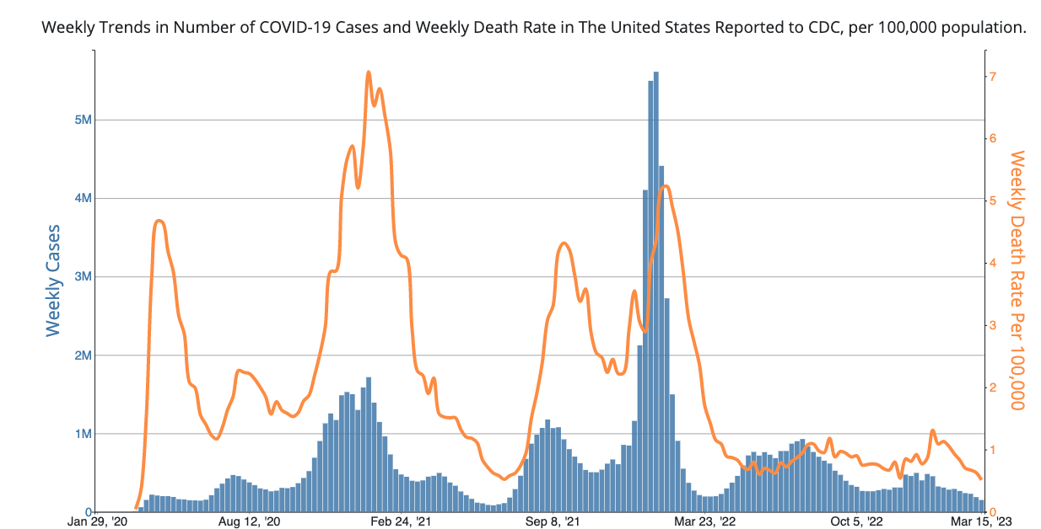
Generally, COVID-19 burden is decreasing in the US and here in King County.

Slide 12
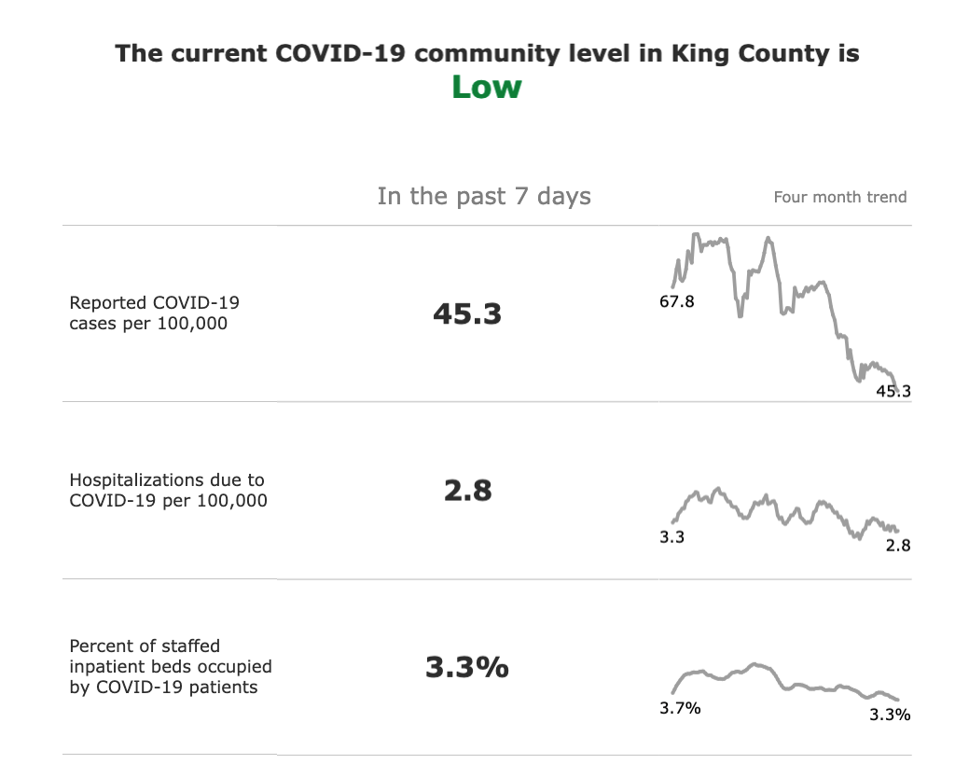
In King County, our current trends show the following:

Slide 13



Keep in mind…
Public Health

Slide 14
Keep in mind…
Public Health receives data from people who seek out testing.
Case counts become less reliable.
We turn to hospitalizations and death data for disease burden

Slide 15
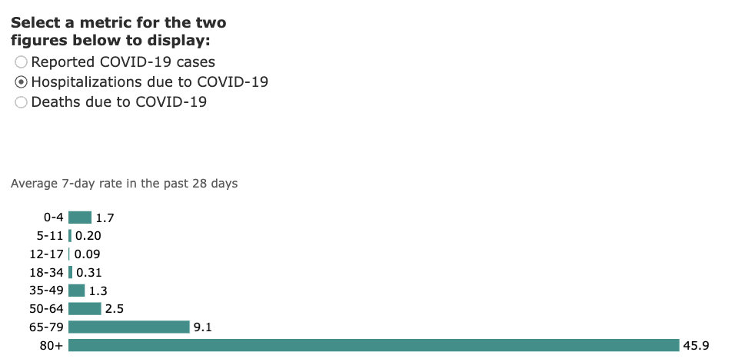
COVID-19 hospitalizations occur disproportionately in older age groups.

Slide 16

COVID-19 vaccinations remain a key part of public health intervention.
. ,l
Hospitalizations
. ,l
Deaths
. ,l
?Long COVID

Slide 17
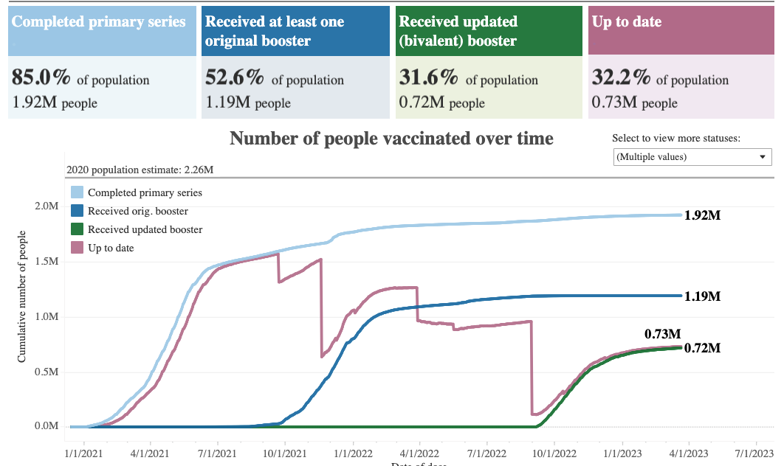
We have had great success with primary vaccines.

Slide 18
But we have a lot more work to do to bring people up to date.

Slide 19
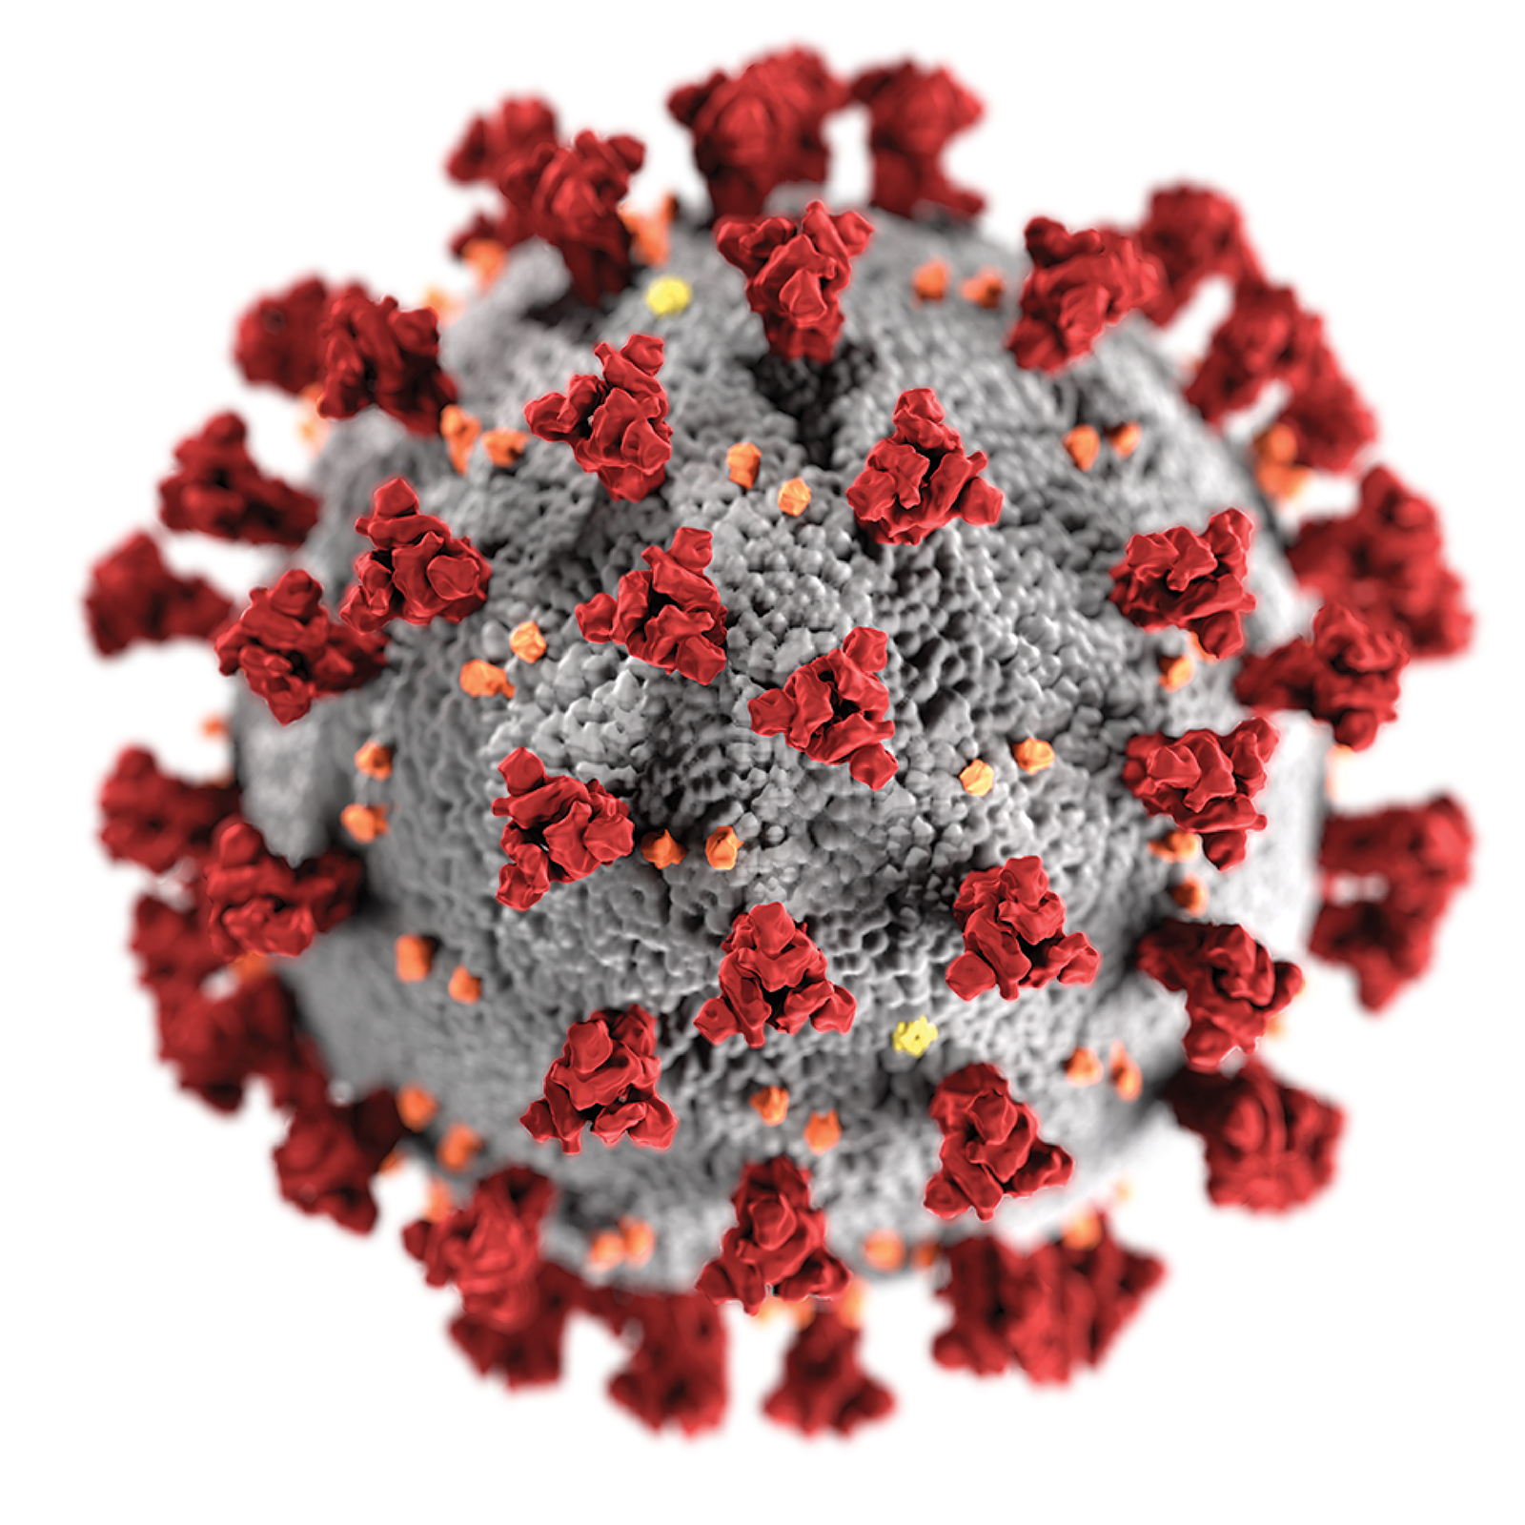
Vaccine preventable infections – COVID-19
Annual boosters made available in the fall
Allows for updates based on the circulating variants
Booster will provide the extra immunity protection especially for those at highest risk for severe disease

Slide 20
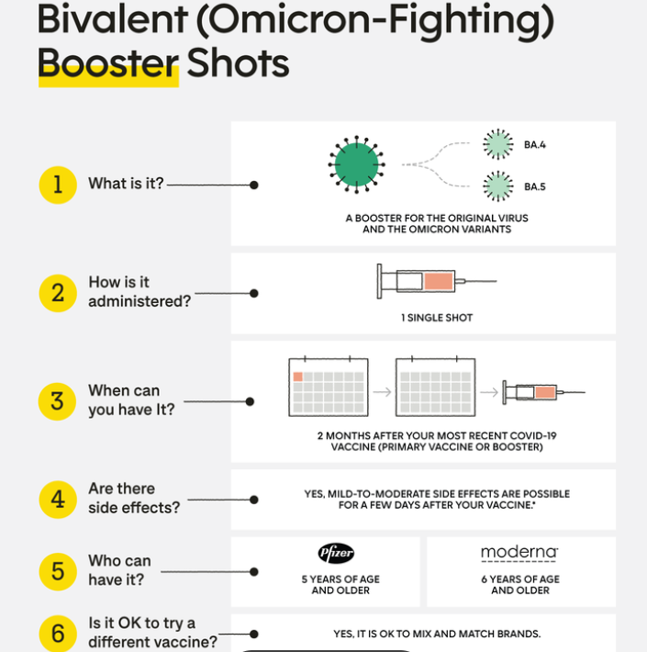
Bivalent (Omicron) Booster

Slide 21
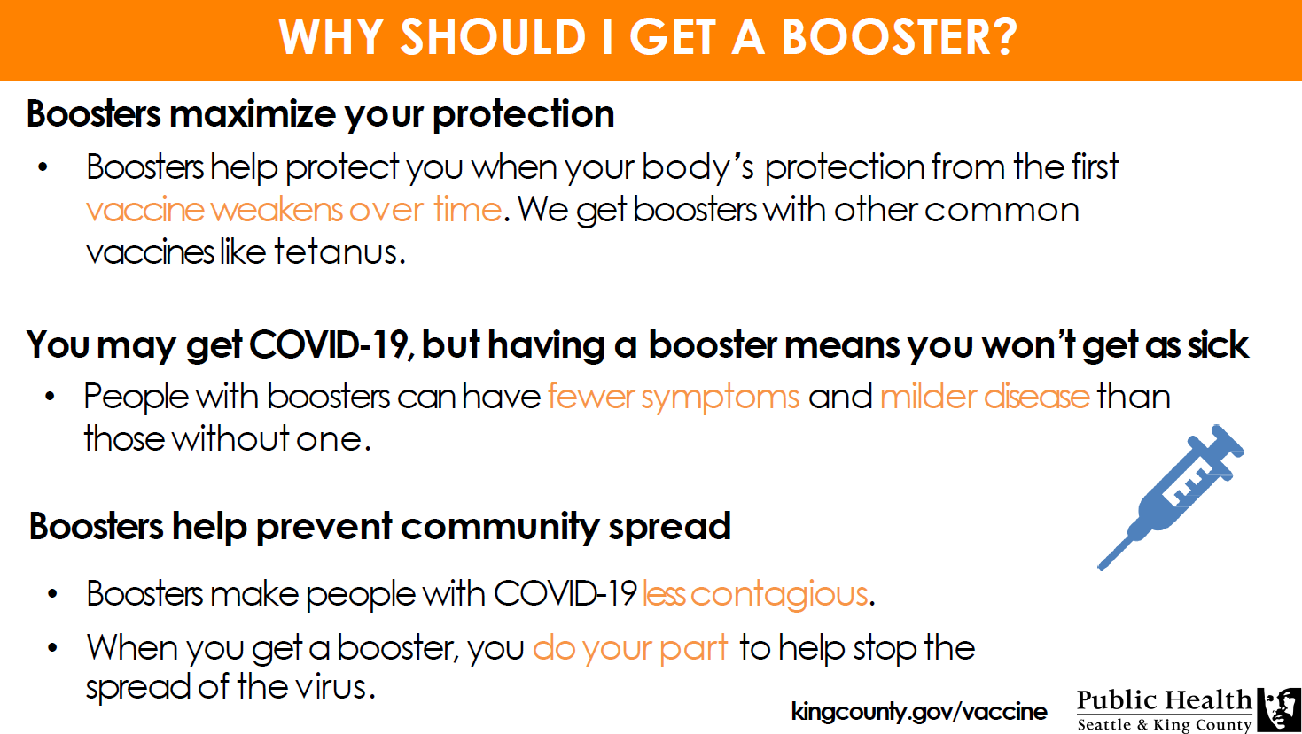

Slide 22
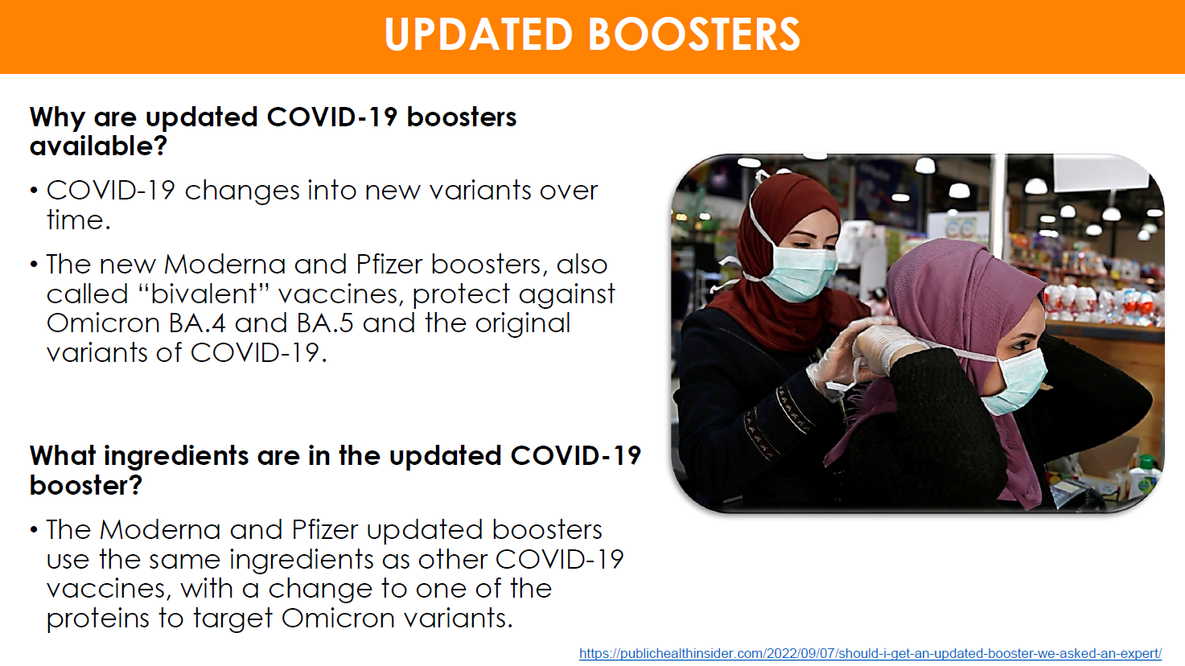

Slide 23
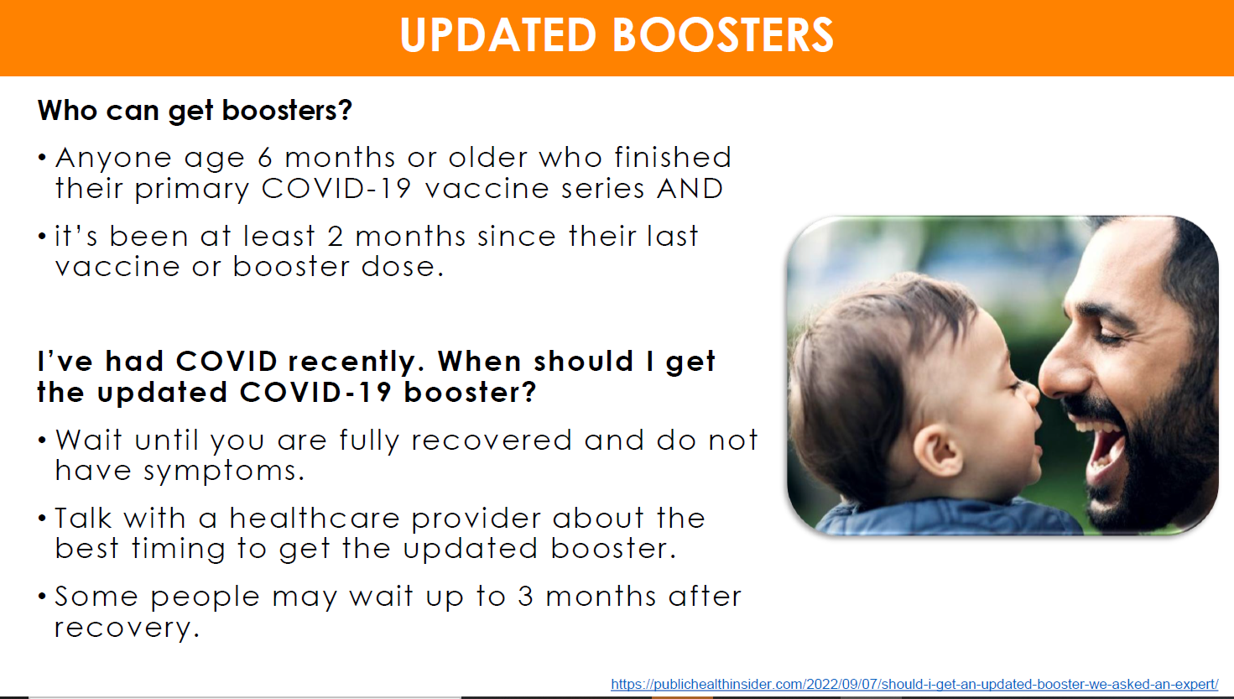

Slide 24

New Updated Bivalent Booster
Who is now eligible to receive the second bivalent booster?
People ages 65 and over.
People over 65 are among those most susceptible to severe outcomes from Covid-19.
These individuals are newly able to receive their second bivalent booster if it’s been at least 4 months since their first bivalent shot.
People who are immunocompromised.
The new guidance from the CDC is that anyone 6 and older with moderate or severe immunocompromise can receive a second bivalent booster if it’s been at least two months since their first.
Depending on their specific medical circumstances, they may be able to receive the bivalent booster as frequently as every two months. They can talk with their provider about this and see if it’s right for them.

Slide 25
Cont.
Is this bivalent booster the same as before?
The updated (bivalent) booster that first became available in fall 2022.
The updated boosters are called “updated” because they protect against both the original virus that causes COVID-19 and the Omicron variant BA.4 and BA.5.
Two COVID-19 vaccine manufacturers, Pfizer and Moderna, have developed updated COVID-19 boosters.
They target both the original strain of the coronavirus as well the BA.4/BA.5 omicron subvariants. It contains two messenger RNA (mRNA) components of the coronavirus. The bivalent booster targets the original COVID and the BA.4 and BA.5 Omicron subvariants, as BA.4 and BA.5 have different spike protein components than the original variant.
Studies have shown that this booster continues to be effective against common current variant, especially in reducing severe illness when people do get COVID.
This second bivalent booster is the same as the previous booster. In other words, it contains the two mRNA cells – one targeting the original strain of COVID and the other targeting the BA.4 and BA.5 Omicron subvariants.
It’s not an option to select the original monovalent shot, and no other type of booster is available.
How has the guidance changed for people who haven’t had the first booster yet, and those who remain unvaccinated?
The bivalent vaccine is going to be the single vaccine made available.
The original monovalent vaccine is not going to be used any more, even in people who have not yet been vaccinated.
This will help to simplify vaccine administration and messaging about vaccines.
People who are 6 years and older who have not been vaccinated before will be considered up to date on their vaccines if they receive just one dose of either the Pfizer-BioNTech or Moderna bivalent booster.
People who have received prior COVID vaccines will still need at least one dose of the bivalent booster in order to be considered up to date.
In King County, as of April 26, 2023, only 32.3% of people (living in King County) have received the updated (bivalent) booster, and only 32.8% of people (living in King County) are up to date on their vaccines. https://kingcounty.gov/depts/health/covid-19/data/vaccination.aspx
In the U.S., as of April 19, 2023, only 16.7% of people have received the updated (bivalent) booster. https://covid.cdc.gov/covid-data-tracker/#vaccinations_vacc-people-booster-percent-pop5
Less than 1 in 5 people in the U.S. are currently up-to-date on their Covid-19 vaccines.

Slide 26
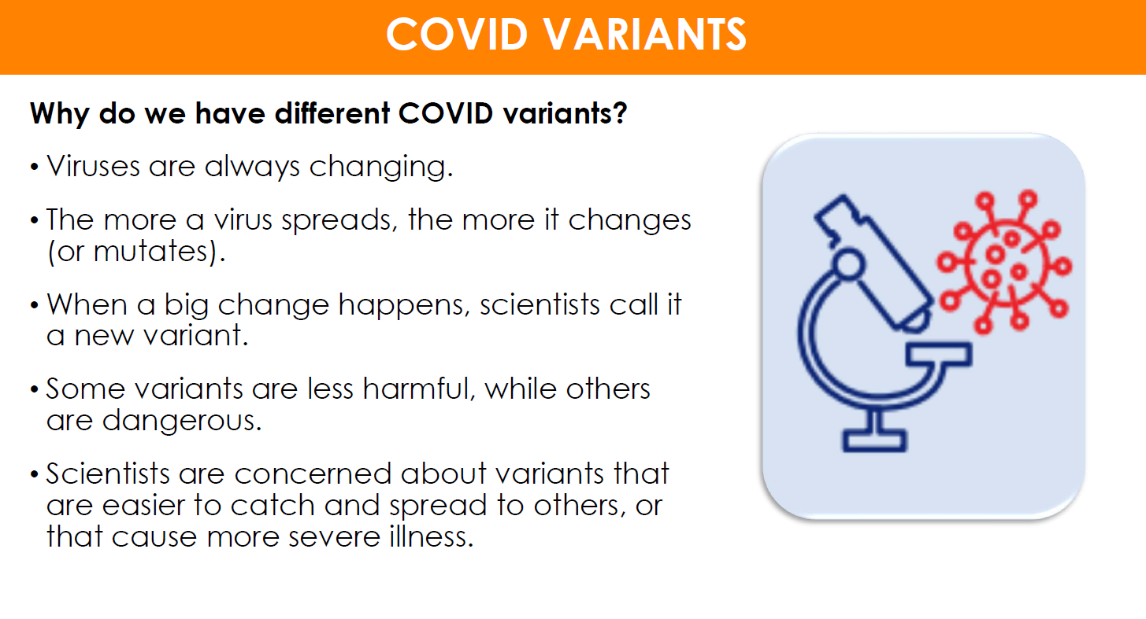

Slide 27
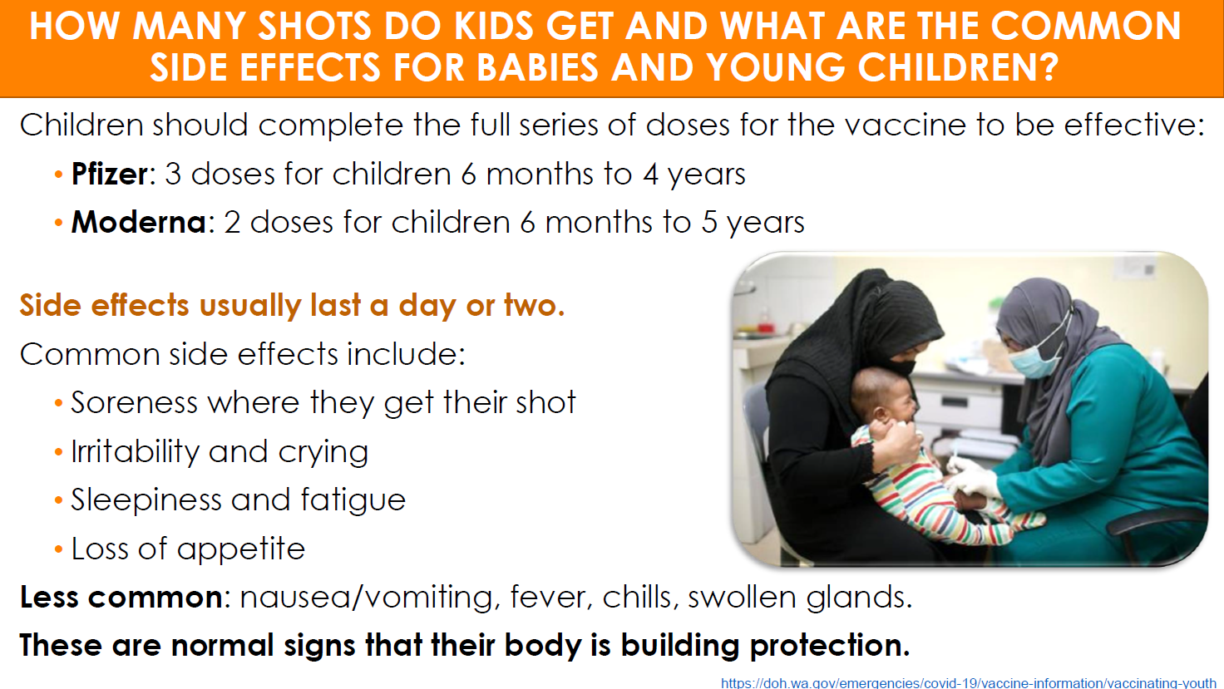

Slide 28
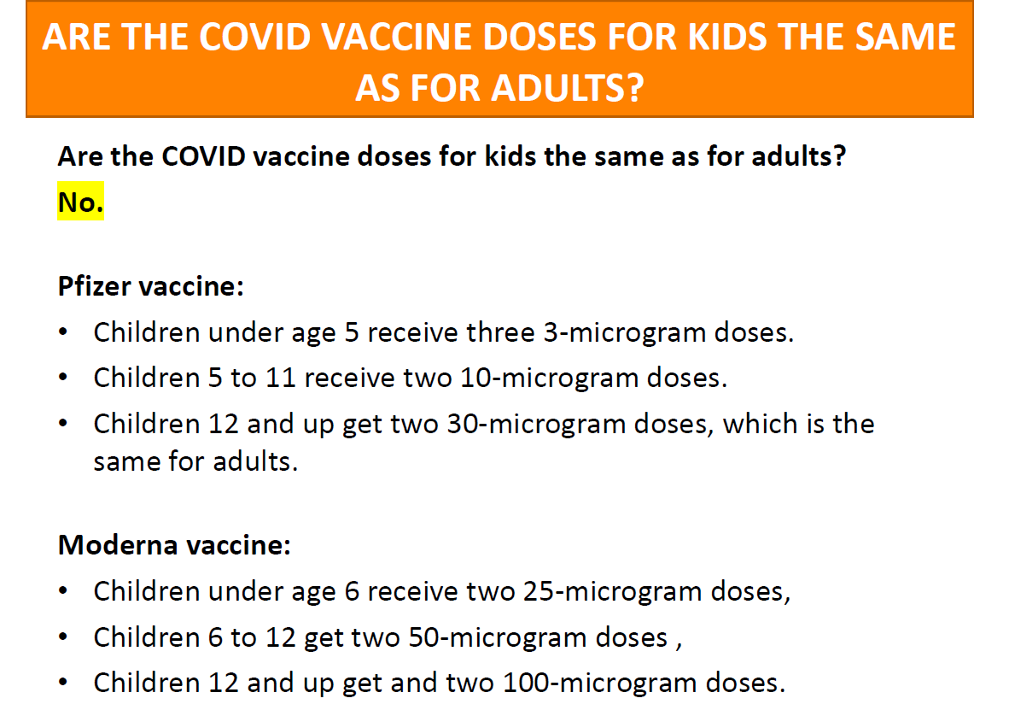

Slide 29
Staying protected against new Variants
The best way to protect yourself from XBB.1.5 subvariant of Omicron is to get vaccinated and stay up to date on COVID-19 vaccines.
Important to assess your risk level and keep that top of mind. If you will be around others in an indoor setting, consider wearing a mask. But not just any mask will do. It is important to wear an N95 or KN95 mask for the best protection.
Avoid poorly ventilated spaces and maintain physical distancing from others. And if you feel sick, stay home and get tested to determine the best course of action.

Slide 30
Q & A ON RECENT KLEBSIELLA OUTBREAK AT VIRGINIA MASON MEDICAL CENTER
Klebsiella is a bacteria that can lead to infections in hospital settings.
common bacteria that can be part of the normal bacteria living in our bodies, including in our intestines. However, sometimes the bacteria can enter a part of the body where it is not normally found and can cause infections such as urinary tract infections, surgical site infections, and pneumonia.

Slide 31
Cont.
A person’s risk of infection depends on a number of different factors which may include procedures they have had or whether they have a weakened immune system.
Klebsiella bacteria don’t spread through the air. In healthcare settings, the bacteria can spread through person-to-person contact, often from contaminated hands. This can happen if you touch someone who has the infection and don’t wash your hands well afterward. Additionally, the bacteria might contaminate environmental surfaces, such as medical equipment like ventilators or catheters. Bacteria can then spread from the equipment to the patient.

Slide 32
Continued.
Cases of Klebsiella associated with this outbreak were identified starting in October 2022
As of 4/28/23, we are aware of 31 cases and 7 people who had died since the outbreak began.
All Cases have been found at Virginia Mason Medical center.

Slide 33
FOOD INSECURITY IN KING COUNTY REMAINS HIGH: HOW TO HELP AND GET FOOD ASSISTANCE
Basic Food/SNAP: King County’s Access and Outreach Team can help you apply and answer questions about Washington State’s Basic Food program. Call the Community Health Access Program (CHAP): at 1-800-756-5437.
SNAP Market Match and SNAP Produce Match: You can stretch Basic Food benefits by purchasing fresh vegetables and fruit at participating farmers markets. Visit SNAP Market Match, email SNAP.MarketMatch@doh.wa.gov, or call 360- 236-3148. Also available is SNAP Produce Match, a program where shoppers who use Basic Food benefits can stretch their food budget to buy more fruits and vegetables at participating grocery stores and online. Visit the website at SNAP Produce Match, email SNAP.ProduceMatch@doh.wa.gov, or call 360-236-3148.
Women, Infants, and Children (WIC) Supplemental Nutrition Program: The WIC program provides families with healthy food, nutrition counseling, and breastfeeding support. You may be eligible for WIC if you are pregnant or postpartum, have an infant, or child under age 5. To learn more, see Public Health WIC Services, or call 206-263-9300.
Senior Farmers Market Nutrition Program: You can find nutrition resources for older adults, including senior congregate meal locations and information about applying for an $80 e-benefit card to purchase fruits and vegetables at participating farmers markets here: agingkingcounty.org/what-we-do/healthy-aging/#sfmnp. Applications open on April 10, 2023. You can also call Community Living Connections at 206-962-8467 or (toll-free) 1-844-348-5464.

Slide 34
More locations
School Meals and Summer EBT: Families can apply for free or reduced-price school meals for their children at any time during the school year by applying directly through their school or school district. School children who receive free or reduced-price school meals qualify for up to a $120 e-benefit card to purchase food during the summer months.
Seattle Fresh Bucks: Eligible Seattle residents with household income below 80% area median income can enroll in the Fresh Bucks program to receive $40 in vouchers a month by mail. The vouchers, allow participants to buy any qualifying fruit and vegetable at any participating retailer including farmers markets, Seattle Safeways, and participating Seattle neighborhood grocers and farm stands. See Seattle Fresh Bucks or call 206-684-2489 for more information.
Food Banks and Meal Programs: Many food banks now offer home delivery services and other conveniences like online ordering and curbside pick-up. Before going to your local food bank or meal program, call ahead to confirm their hours and to make an appointment, if necessary. Find your closest food bank or meal program by visiting this list and map of food resources.

Slide 35
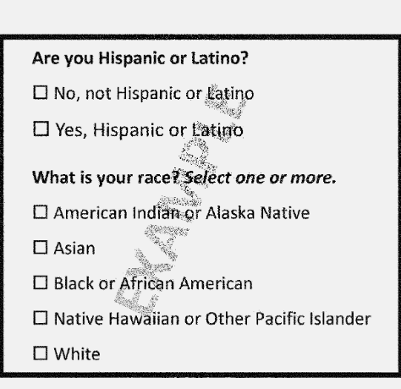
Change how the U.S. census and federal surveys produce racial and ethnic data
Federal Register :: Initial Proposals For Updating OMB's Race and Ethnicity Statistical Standards
taking steps that could change how the U.S. census and federal surveys produce racial and ethnic data that is used for redrawing voting districts, enforcing civil rights protections, policymaking and research.

Slide 36
Next Meetings:
May 31st – 3:30-5pm
June 28th – 3:30-5pm

