Slide 1
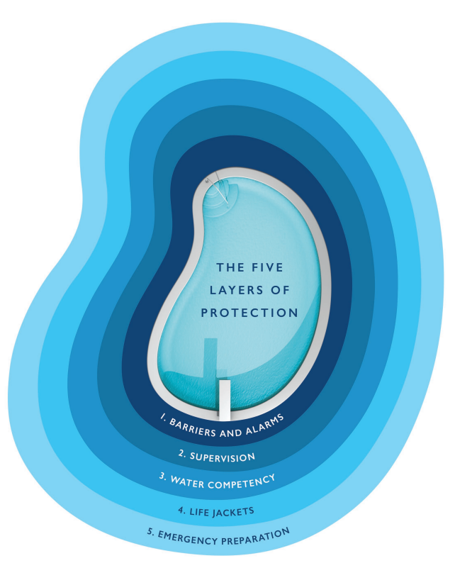



Water Safety
Infants
Young children
Adolescents
www.ndpa.org
www.aap.org
Notes:
https://ndpa.org/wp-content/uploads/2022/09/FINAL-LOP-Brochure.pdf
Incidences peak in children aged 0-4 years and adolescents aged 15-19 years (Dorney et al., 2020)
Infants (less than 1 year): bathtub or bucket
Young children (1 to 13): swimming pools
Adolescents (14 to 17): natural bodies of water

Slide 2
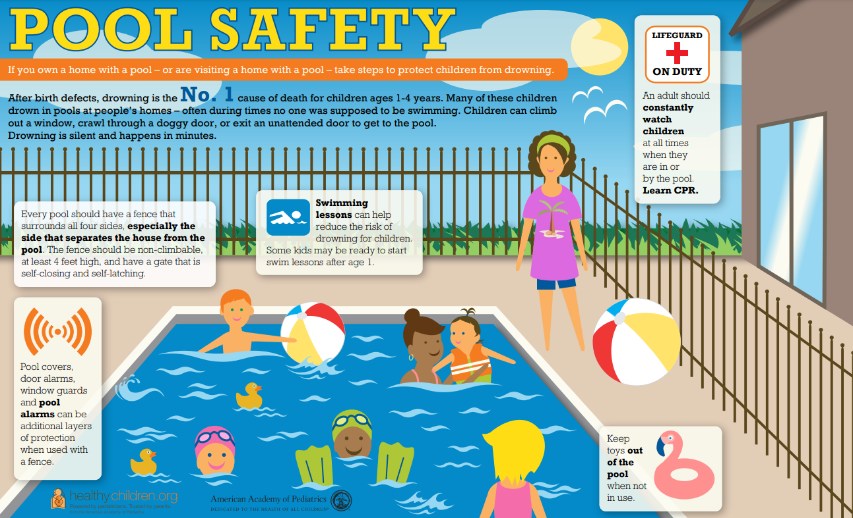
Notes:
https://downloads.aap.org/DOPA/Drowning-Prevention/pool_safety_english.pdf

Slide 3
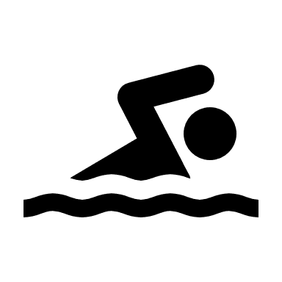
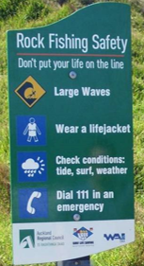


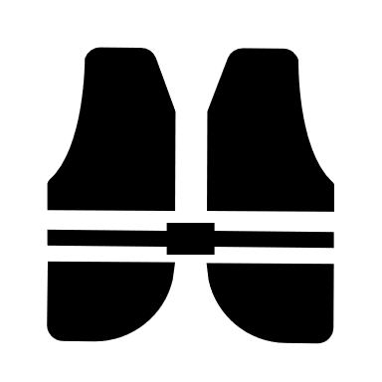


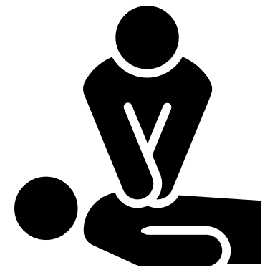
Water Safety
In or on water
Use designated swimming and recreational areas.
Check weather and water conditions.
Follow all safety signs and warning flags.
Bring life jackets or check for a loaner station.
Stay close to shore and rest when tired.
Don’t swim alone and supervise children and teens.
Know what to do in an emergency.
www.seattlechildrens.org/dp
Notes:
Most unintentional drowning deaths occur in open water settings (lakes, rivers, creeks, oceans).
Swimmers tend to tire fast and get into trouble more quickly than in pools.
Expect cold waters – even on hot summer days.
In King County: Preventable drownings have continued to rise over the past 5 years, and 29 people lost their lives to drowning in 2021, including 15 in open water (Public Health)

Slide 4
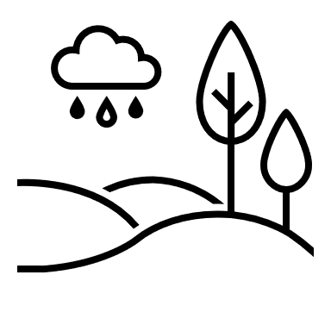

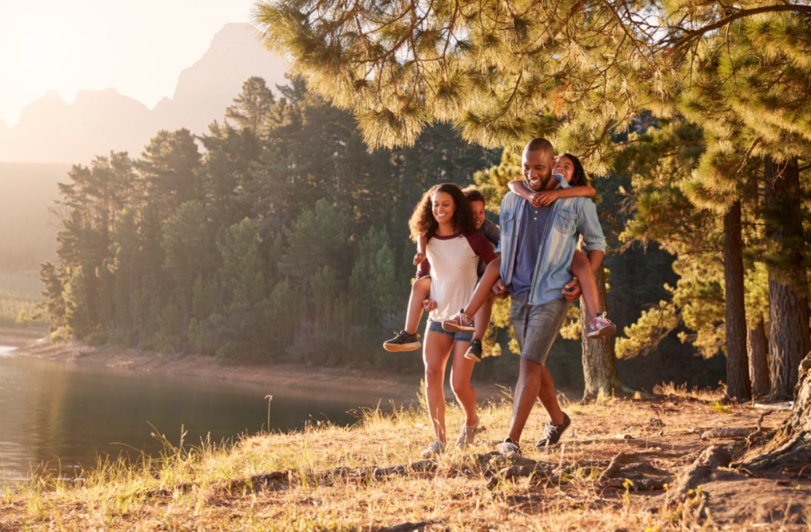
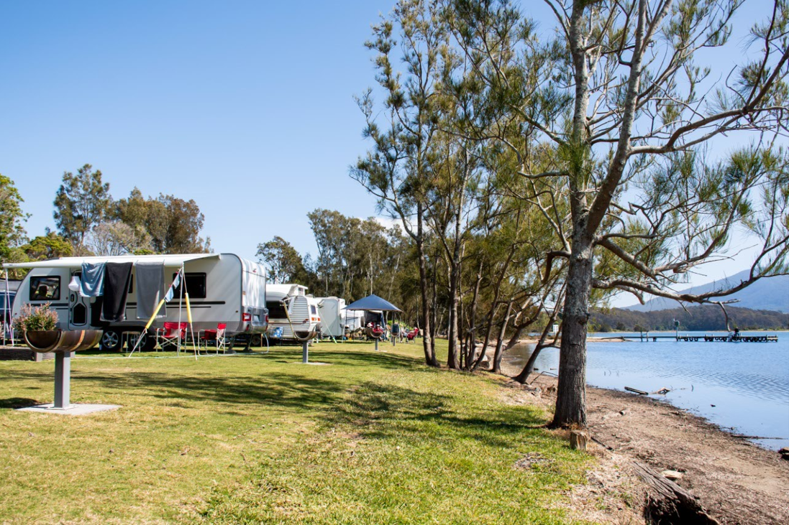
Water Safety
Around water
Get familiar with surroundings beforehand.
Always keep children in sight when water is nearby.
Have young children wear a life jacket when playing on a dock, boat, etc.
Know what to do in an emergency.
www.seattlechildrens.org/dp
Notes:
Learn to swim and upgrade swimming skills each year
Learn what to do in an emergency (First Aid and CPR)
Check life jackets
Have conversations about ways to stay safe in and around water
Keep homes safe
@home
Never leave a child alone in or near water, including in the bathtub.
Place a non-skid mat or non-slip strips in the bathtub or shower.
Keep the toilet lid closed, and use a lid lock.
Empty buckets that have liquid in them.
Have your child wear a life jacket on boats, on docks and around lakes, rivers and the ocean.
Fence all four sides of a swimming pool, hot tub or spa.

Slide 5
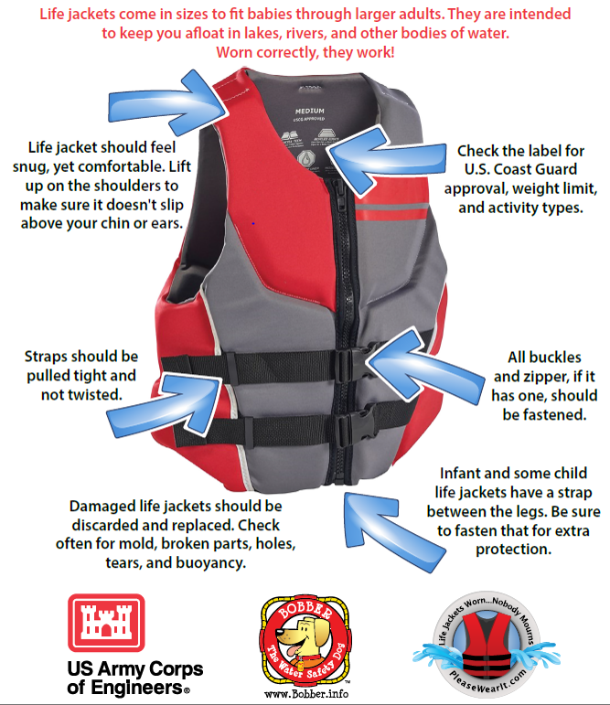
Notes:
Different life jackets for different activities
Sizes are typically guided by weight
Bright colors are best for easier identification in water

