Slide 1
CHW Facilitation Skills
Part 1: Introductions and setting agendas
Kim Dawson

Slide 2
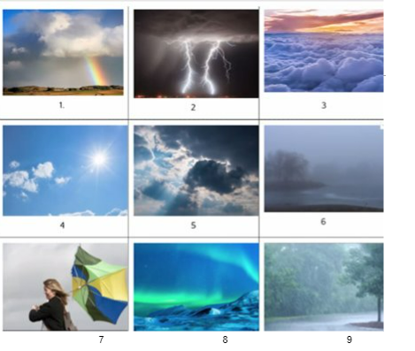
How are you “weathering” as you enter today’s workshop?
In the chat, please introduce yourself by typing your name, organization, and the number of the weather photo that best matches how you are feeling today.
Example: Kim Dawson, CHW CARE, #8

Slide 3

Introductions
Welcome. No matter what brought you here, you are in the right place.
We are grateful for all you bring to this course.
We are excited to learn together.

Slide 4

Collectively improving our presentation and facilitation skills
What brings us together today…

Slide 5
Our learning program
What to expect
Broader goal: Build confidence and excitement for facilitating & presenting!
Goals by session:
Session 2:
Examining Zoom etiquette, and building inclusive & accessible spaces
Aug. 8
Session 3:
Time management, and managing ambiguity or conflict while facilitating
Aug. 22
Session 1:
Introduction to facilitating & presenting, and setting agendas
July 25th

Slide 6
Understanding the difference between presenting and facilitating
Acknowledging the importance of CHWs as presenters/ facilitators
Learning how to set a solid agenda
Understanding the difference between open and closed questions, and when to use them
Skills we will build on today:
Session 1

Slide 7

Honoring the wisdom already
in the room
We deepen our learning journey together with authentic engagement, personal sharing and meaningful dialogue.
We focus on the practical.
We utilize and value the wealth of experience and knowledge in this room.
We are on this learning journey, together.

Slide 8
We participate thoughtfully, and make space
We limit our distractions where possible and practice being present
We do what we need to take care of ourselves
We support multiple truths, allow differing perspectives to co-exist
We allow ideas and conversations to exist un-finished, without closure when necessary
Zoom
Please stay on mute if you’re not talking
Please use your camera, when possible and comfortable, to help us foster community and shared space
Don’t be afraid to use chat box or raise hand icon!
Group
norms
Anything you’d like to add?
Feel free to share aloud or by adding to this document at any time.

Slide 9

A note about breaks
Breaks are self- care.
Learning something new is always challenging – give yourself grace
We will have one scheduled break at 10:50am, however please at any time do what you need to do to take care of yourself

Slide 10

Defining terms
Presenting
The speaker does most of the talking - They are the "star" of the show.
A presentation is linear.
The speaker has a point and a destination – Their goal is to share information; to get a group of people to think a certain way about topic, or understand a topic.
Facilitating
The audience does most of the talking.
The facilitator provides the destination and guideposts but allows the class to experience their way through the material.
The facilitator allows the class to go back, move sideways, return to the start and/or anything else that helps them understand the material.
Citation: Jared Larson, “What's the Difference? Presentation vs. Facilitation”

Slide 11
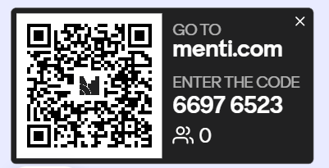
Poll!
So we can learn a little bit more about each other…
  Have you facilitated or gave a presentation before?
  What is your comfort with facilitating/presenting?
  What is one area you want to grow in facilitating/presenting?
Mentimeter

Slide 12

CHWs as facilitators
It’s a natural fit.
CHWs have skills, qualities, and values that lend well to being strong facilitators and presenters.
Learning new skills or building on existing, leads to growth.

Slide 13
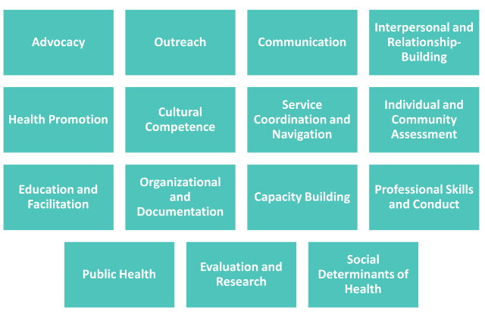
CHWs Core Competencies

Slide 14


CHWs as facilitators
Beginning with a memory
Reflect on a time where a facilitator/presenter led an experience you really liked
What about it made the experience meaningful and still memorable to you?
It’s a natural fit.
CHWs have skills, qualities, and values that lend well to being strong facilitators and presenters.
Learning new skills or building on existing ones leads to growth.

Slide 15
Breakout or personal
reflection
Things to think/share about:
(Pick 1-2)
How do you anticipate using these skills? What will be relevant or useful to you?
What facilitation skills do you realize you already have experience in?
What facilitation skills do you want to dedicate more energy to developing?
What feels a little scary right now? What excites you?
10 minutes. Choose from “Group” or “Personal time” break out rooms.

Slide 16

We’re off to a great start.
Let’s take a 5 min break before continuing.
Stretch, grab a beverage, pet your dog, or just step away from your computer!
When we come back, we’ll talk about how to set up an agenda.
Time to
Pause

Slide 17
Welcome
back!
Now we’ll talk about how to set an agenda.

Slide 18


Let’s make a list
Quick! Pick 1, and take 2 minutes to ….
OR
Make a grocery list
Make a vacation packing list

Slide 19
Grocery list: Did you group by food category (dairy isle vs meat, produce, etc.)
Maybe you listed by what store you need to buy things from (basic staples, vs. specialty store)? Or maybe by what recipe you would be making?
Vacation packing list: Did you group by day of the week? Maybe you listed by activity planned, or what weather you would be dressing for?
We make agendas everyday. How you plan and group things makes it easier to follow along.
Notice

Slide 20
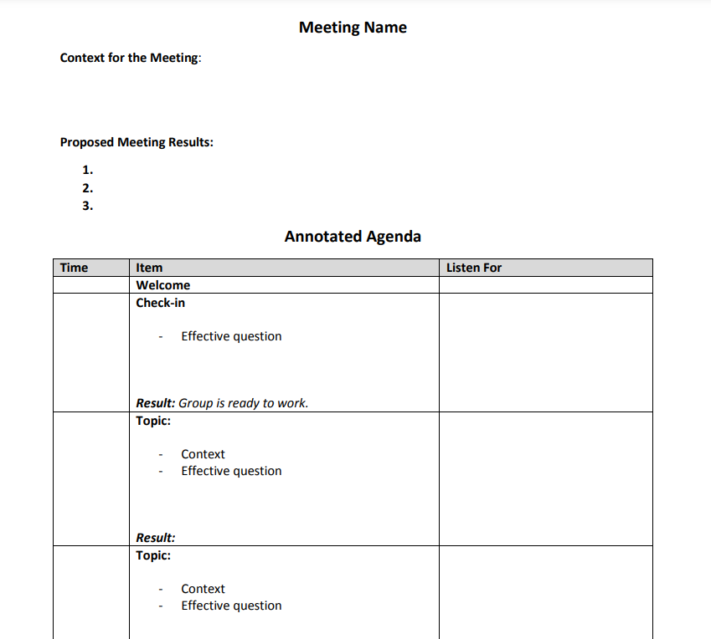
Agendas for facilitating
Template

Slide 21

Know the end goal
Set an agenda beforehand and know what the end goal(s) are
Do we need a meeting? Or should this be covered in an email?
  Typically, email is a better fit for relaying information
  Meetings are better for planning and discussion
Why are we meeting and what do we want out of our time together?
Are the right people here?

Slide 22

Resist temptation to overload
Consider what is reasonable to accomplish in your time together
Think about how long each portion will take
If that portion runs over is that OK? Are you ready to shorten or take out other sections?

Slide 23
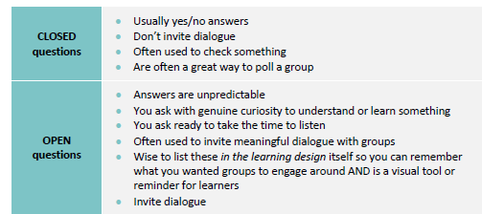
Consider what input you need
What are your goals of your presentation or meeting you are facilitating? Is it to share out on decisions that have already been made? Is it to educate on a topic? Do you need feedback?
Questions should align with your goals.
If you want yes/no answers…
Go with closed questions
If you want dialogue and feedback…
Open questions

Slide 24

Question Examples
Open
What are some opportunities our organization has if we have a table at the resource fair? What services do we want to promote?
Results in discussion
Closed
Do you think our organization should have a table at the community resource fair?
Results in a “Yes/No” answer

Slide 25

Consider the meeting flow
Consider the sequence of the topics you are planning
Pick the order based on several variables:
Order | Consideration | Example
Logical | Do we need to talk about one topic to decide on another topic? | Deciding what theater location, you and friends will see a movie at together, and then picking a nearby restaurant
Energy/ bandwidth | What will the group’s energy level be for discussing this topic at the beginning as opposed to later in the meeting? *If something is urgent, saving it for the end might result in not getting to the topic before running out of time | If you know picking a restaurant will take a lot of energy to decide amongst your group of friends, pick the restaurant first, and then find the closest theater to see a movie afterwards

Slide 26

Practice
opportunity
Take the agenda template to your next meeting (or make your own!).
Set the agenda for the meeting or take notes during the meeting what you witness in the agenda presented to you.
Come back for Session 2, to let us know how it goes!

Slide 27
Closing
Reflect on two takeaways you’re leaving with from this first session today
Practice Opportunity: Set the agenda!
Join us for Session 2!
  Topic: Examining Zoom Etiquette, and building inclusive & accessible spaces
  Date: August 8th 10am – 12pm

Slide 28
Thank you
  Email: kidawson@kingcounty.gov

