Slide 1
CHW Facilitation Skills
Part 2: Examining Zoom etiquette, and building inclusive & accessible spaces
Kim Dawson

Slide 2

Grounding in
Desk stretches and mindfulness moments
Notes:
Start by sitting up right, put both your feet on the floor… grounded
Shoulder back
Neck rolls
Hold a side next stretch
Now transfer other side
Lets bring our arms above head in a big sun saluation
Coming up as slowly as you can
Once youre at the top extend to push up just one more stretch that you can
Bend to the sides
Twist
Intuitive movement – on your own listen to your body on what movement it needs next
Sit back down for some deep breathing
How it connects to body language

Slide 3

Introductions
Welcome. No matter what brought you here, you are in the right place.
We are grateful for all you bring to this course.
We are excited to learn together.
Notes:
10:10
Brief. Thank people who joined the first session, and welcome people joining for the first time now

Slide 4

Collectively improving our presentation and facilitation skills
What brings us together today…
Notes:
Brief reminder for those who previously attended, letting new people know.

Slide 5
Our learning program
What to expect
Broader goal: Build confidence and excitement for facilitating & presenting!
Goals by session:
Session 2:
Examining Zoom etiquette, and building inclusive & accessible spaces
August 8th (Today!)
Session 3:
Time management, and managing ambiguity or conflict while facilitating
August 22nd
Session 1:
Introduction to facilitating & presenting, and setting agendas
July 25th
Notes:
Brief reminder for those who previously attended, letting new people know.

Slide 6
Learn techniques for “grounding in” and beginning a meeting or presentation
Understand the importance of body language and what it communicates
Reflect on practices that build connection, inclusion, and accessibility
Skills we will build on today:
Session 2

Slide 7
We participate thoughtfully, and make space
We limit our distractions where possible and practice being present
We do what we need to take care of ourselves
We support multiple truths, allow differing perspectives to co-exist
We allow ideas and conversations to exist un-finished, without closure when necessary
Zoom
Please stay on mute if you’re not talking
Please use your camera, when possible and comfortable, to help us foster community and shared space
Don’t be afraid to use chat box or raise hand icon!
Group
norms
Anything you’d like to add?
Feel free to share aloud or by adding to this document at any time.
Notes:
Brief reminder for those who previously attended, letting new people know.

Slide 8

A note about breaks
Breaks are self- care.
Learning something new is always challenging – give yourself grace
We will have one scheduled break at 10:45 however please at any time do what you need to do to take care of yourself
Notes:
Brief reminder for those who previously attended, letting new people know.

Slide 9
Agenda
Time | Topic
10 -10:10 am (10 minutes) | Grounding in exercise
10:10 – 10:20 (10 minutes) | Introductions
10:20 – 10:45 (25 minutes) | Getting into facilitator mindset & building our centering practices
10:45 – 10:50 (15 minutes) | Break
10:50 – 11:05 (15 minutes) | Body Language
11:05 – 11: 20 (15 minutes) | Zoom Etiquette
11:20 – 11:50 (30 minutes) | Connection, Inclusion & Accessibility
11:50 – 11:55 (5 minutes) | Closing
To follow along on the agenda, see Session 2 on CHW CARE courses

Slide 10

Speaking of agendas…
How did using an agenda after last session go?
Would anyone like to share?
Notes:
10:15

Slide 11
Grounding in
Life is busy, and full. As humans our attention is pulled in many directions.
Grounding in is a practice of centering so that we can, as much as possible, be present with one another in this space and time.
There are many ways to “ground in.” Use one or however many you want in your next meeting!
Examples…
Sharing an agenda
Doing an activity at the start
Turning the connection inward where those in the meeting/ training talk with one another
Playing music
Notes:
10:20

Slide 12
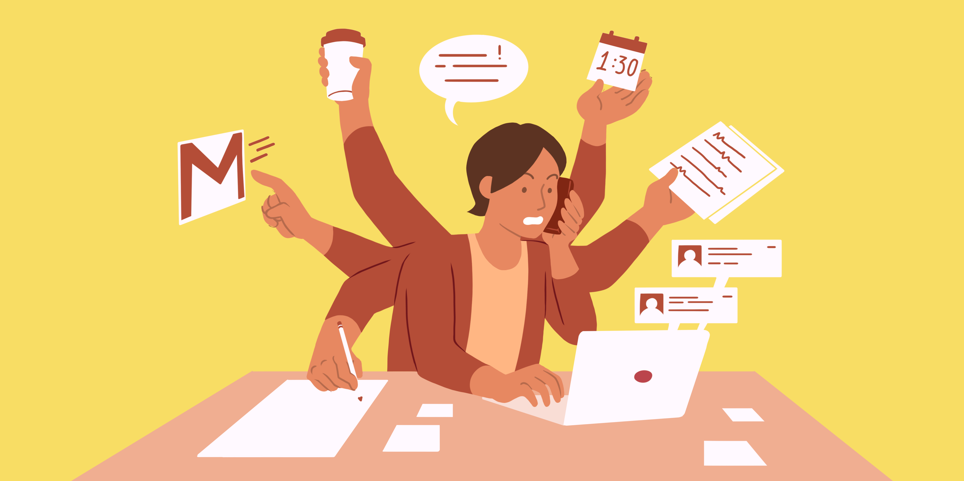
Why ground in?
Multitasking is the one of most difficult things for our brains to do. When we put undue stress on ourselves, we impede our ability to be present, connect, focus, or learn new information.
We exist in a system. Especially since the start of the pandemic, and an increasingly more virtual world, we are being asked to do more and more.
Give yourself permission to be in one place.
Notes:
Ultimately grounding in helps us start from a place of being more focused participants that feel connection between themselves and other learners; which hopefully gets us closer to achieving any given goal of that meeting.

Slide 13
Facilitator’s role in grounding
A facilitator needs to know what kind of energy they need to bring to the group. A facilitator’s energy and demeanor are key to setting the tone.
Facilitators read the room, understand the participants, understand the objectives of the group, and adapt when necessary.
The ability to manage emotions in the room helps keep conversations constructive and moving towards the goal - whether it’s an upbeat brainstorming activity or serious discussion needing to be had. (We’ll talk more about this in Session 3!)
A good facilitator can help to inspire, motivate and support the group

Slide 14

Getting in the facilitator mindset
You can’t support others until you first support yourself.
As a facilitator, it’s important for you to have routine or practice that gets you into the right headspace.
  Note: This means also checking in with your physical body… are you hungry? Do you need to use the bathroom before you start? Do you have something to drink sitting with you?
Even experienced facilitators feel nervous!
Centering yourself before starting your meeting can help you build the confidence to adequately show up for others in a meaningful way.
Notes:
Facilitator having a routine to get into the right headspace
Acknowledging that even experienced facilitators can feel some nervous energy before facilitating, maybe it’s a new audience or a fairly new topic to you… maybe something happened in your personal life.
Centering yourself before starting your meeting can help you build the confidence to adequately show up for others in a meaningful way

Slide 15
Let’s share what each of us do to calm nerves, find confidence, and center ourselves to show up for others!
Feel free to come off mute to share your practices aloud or add to the JAM Board.
After todays, session I’ll circulate our shared practices so that you have the group’s strength and ideas to pull from the next time you need to shake nerves before facilitating!
Building our centering
practices
Notes:
https://jamboard.google.com/d/1ZhP9pZuYulxz6FAjk-fJYVkwyemfQsk1sjMR1P1z9JM/edit?usp=sharing

Slide 16

Lights.
Camera.
Action.
Notes:
So you’re in the right headspace, you’ve got your favorite beverage in front of you and just took your dog for a walk. Folks are walking into your presentation, or in the virtual waiting room… and you’re about to start. What does grounding in look like?

Slide 17
Grounding in ideas
Having music playing as participants enter the meeting (be it virtual or in-person)
Respectfully asking that if participants are able, limit distractions: silence phone, close tabs on laptop etc.
Respectfully asking that if participants are able, turning on camera
  Explain that if we were in person we would be able to read off each other’s body language; having camera helps us stay connected
Optional breathing exercise (feeling feet on the ground and a few deep breaths to slow down and feel rooted)
Have participants think about why they came to the meeting
Honor the wisdom, knowledge, and experience already in the room
Have participants introduce themselves
Get participants talking to each other
Establish group norms
What are your ideas? Come off mute to share your practices aloud, or add to JAM Board
Notes:
After todays, session I’ll circulate our list so that you have the ideas to pull from next time you need it!

Slide 18

We’re off to a great start.
Let’s take a 5 min break before continuing.
Stretch, grab a beverage, pet your dog, or just step away from your computer!
When we come back, we’ll talk about body language while presenting.
Time to
Pause
Notes:
10:45

Slide 19
Welcome
back!
Now we’ll talk about body language while presenting.

Slide 20


Body language…..
Are we talking about in-person or online?.....
Both!!
In - person
Online

Slide 21
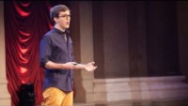
Body Language Video

Slide 22
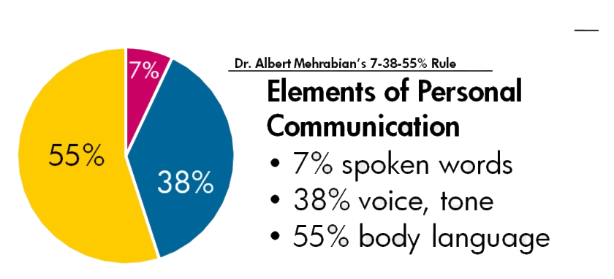
Body Language
Eye contact
Movement & posture
Show active listening, nodding, verbal cues, repeat back what you heard a participant say.
Notes:
Paraphrasing, summing up, or using other active listening techniques are great ways to fully grasp and gauge the meaning of what people are saying.

Slide 23

A note about virtual body language….
“Zoom etiquette”
Notes:
11:05

Slide 24
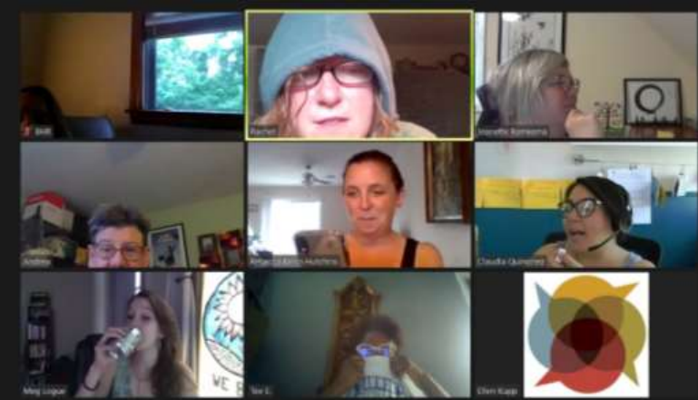
What’s wrong with this picture?
Thank you, Global Learning Partners for sharing this example:

Slide 25

Virtual body Language
Place your camera at eye level
Check the lighting
Consider your background
Pick a quiet (enough) location
Look into the lens
Sit in the center of the screen
Keep attention
Share facial expressions as people speak
Be aware of when it’s good to be muted, and when to unmute, or use chat box
Turn your video off when you step away
Citation: Global Learning Partners, Read more recommendations for visuals during online meetings, and sound

Slide 26

Sound
Perhaps the most important rule within “zoom etiquette” is muting your microphone when you’re not speaking.
With many more working remotely than before the pandemic, we know our homes have different sounds than a workplace… and that’s OK!
However, background sound can at best distracting, and at worst communicate that you are disinterested. Additional sound can be particularly distracting for folks with auditory or other sensory disabilities.

Slide 27
What can you do if you hear background sound while presenting?
Politely ask those attending to check their microphones, and to stay muted while not talking
  What this sounds like: “Hey team, I’m hearing some sound feedback. It’s a little distracting because I can’t tell if someone is commenting on the presentation or if it’s just background noise. Can everyone look at their microphones now and check if you’re muted? Thanks so much.”
Mute people directly using the tech on your video call platform

Slide 28

Building inclusivity and fostering connection
Notes:
11:20

Slide 29
Connection
Connection drives our engagement, learning, and ability to integrate what we’ve learned. Connection fuels our flame and gives purpose.
Tips for connection:
Refer to participants by name
Remember things about your participants and refer back to these bits of information, relate to something they shared.
Where possible, call on people in the order they raise their hands or comment in chat to demonstrate fairness, and equal attention
Show active listening with body language
Ask questions and stay curious
Notes:
, o Adults need to feel included in the learning process, to see that their perspective matters, and to trust that their voice is invited and heard. Facilitators must be sensitive to how the dynamics of gender, age, physical ability, education, culture, religion, ethnicity, and community position (e.g. power) influence participation in any given event. They should watch for the balance of voices and perspectives raised in the group and design/facilitate in ways that intentionally draw on the varied expertise and experience in the room.

Slide 30
Inclusion
People need to feel included to trust that their voice is invited and heard, and know their perspective matters.
Facilitators must be sensitive to how the dynamics of gender, age, physical ability, education, culture, religion, ethnicity, and community position (e.g. power) influence participation.
Tips for inclusion:
Facilitators should watch for the balance of voices and perspectives raised in the group and design/facilitate in ways that intentionally draw on the varied expertise and experience in the room.

Slide 31
Accessibility
We can’t build connection and inclusion with folks, if they’ve not even in the room. And once they’re in the room, do they have the same access to participation as everyone else?
Tips for accessibility:
Knowing what languages need to be available, providing interpretation services
Speak loudly, clearly, and at an even pace
Use large font
Consider sharing materials beforehand
Give clear instruction
Activities that balance introvert and extrovert strengths
Taking breaks
Providing food
Consider timing and location of presentation
  If virtual, does your audience have wifi accessibility?
Remove obstacles
  If in person, are there any obstacles for physical mobility?
  If virtual, closed captioning
Notes:
Before doing an activity, put yourself in the shoes of the participant. Think “what might be confusing about this activity” What can I do to design this activity or explain it that might mitigate that confusion

Slide 32
What’s resonating for you on topics of connection, inclusion and accessibility?
Where do you want to continue the conversation with a small group?
What is one take away you have from our session today?
Break
Out
10 min
Notes:
11:35

Slide 33
Closing
Share out – what did your small group discuss that could benefit the whole group?
Practice - Lead a grounding – in activity at an upcoming meeting.
Join us for Session 3!
  Topic: Time management, and managing ambiguity or conflict while facilitating
  Date: August 22nd 10am – 12pm
How to be in touch
  Slack
  Survey - Let us know how today’s session went
  Email: kidawson@kingcounty.gov
Notes:
11:50

Slide 34

Practice
opportunity
Revisit some of the ideas we generated on JAM board.
Pick one to lead a grounding-in activity at an upcoming meeting.
Come back for Session 3, to let us know how it goes!
Notes:
11:55

Slide 35

For folks wanting to stay connected and share their experience between sessions, I've put together a Slack channel here! You'll need to use an email account to sign-up (free), but once you're in you can chat message fellow CHWs, share experiences with agenda-setting on the discussion board, and build community.
I’ll hang back after this meeting if folks have questions about Slack.
Notes:
11:55
https://join.slack.com/t/chwcare/shared_invite/zt-2009aa1gn-qZUZl0Xf2BO1KKsSL5lmuQ

Slide 36
Thank you
After you exit today’s Zoom meeting, a survey will automatically pop up to ask you about how today went for you!
This feedback helps us improve and generate new ideas for the next session!
  Email: kidawson@kingcounty.gov

