Slide 1

Food Insecurity
Notes:
This slide will be displayed while folks are getting registered and seated

Slide 2

Housekeeping and Introductions
Notes:
Joyce -

Slide 3
Agenda for the day:
11:00 - 11:30 Check-In
11:30 - 11:45 Welcome/Introductions/Housekeeping
11:45 - 12:30 Food Insecurity Introduction with Qulina
12:30 - 12:35 Break
12:35 - 1:00 Levels and effects of food insecurity with Qulina
1:00 - 1:30 Lunch
1:30 - 1:55 Mandates to attempt managing food insecurity with Estella
1:55 - 2:00 Break
2:00 - 2:45 Data and Conversating about food insecurity with Estella
2:45 – 3:00 Role Play Exercise
3:00 – 3:15 Community Resources Available with Joyce
3:15 – 3:30 Questions and Evaluations
Notes:
Joyce – Each individual table should have an agenda of the day.

Slide 4

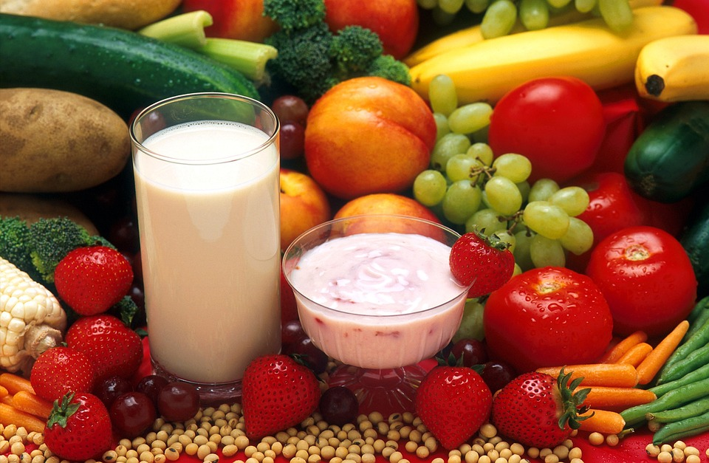
Learning Objectives:
Be able to say what food insecurity means and how it affects so many people in the U.S.
Know the root causes of food insecurity.
Have examples of food insecurity evaluation tools.
Know the difference between food insecurity and hunger.
Have an understanding of the sensitivity of this subject when speaking to clients/patients and know how to approach the conversation.
Notes:
Qulina - Learning Objectives: by the end of this training, you should:
A video is next

Slide 5
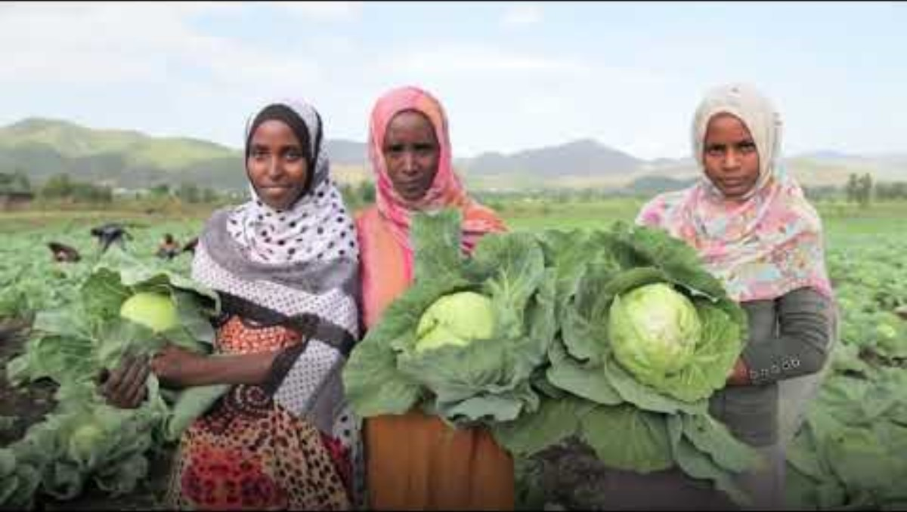
Notes:
Now we will watch a video

Slide 6
Food Insecurity:
When people don’t have food and don’t know where their next meal is coming from. It is a huge problem in the United States, where over 44 million people, including 13 million children, experience food insecurity annually.
https://www.ers.usda.gov/topics/food-nutrition-assistance/food-security-in-the-u-s/definitions-of-food-security/
Notes:
Qulina – video is next

Slide 7

Notes:
Now we will watch another video

Slide 8
Food Security v/s Insecurity
Food Security/Access
Food Insecurity
High Food Security/Access:
No reported indications of food access problems or limitations.
Marginal Food Security/Access:
One or two reported indications- typically of anxiety over food sufficiency or shortage of food in the house. Little or no indication of changes in diets or food intake.
Low Food Security:
Reports of reduced quality, variety, or desirability of diet. Little or no indication of reduced food intake.
Very Low Food Security:
Reports of multiple indications of disrupted eating patterns and reduced food intake.
https://www.ers.usda.gov/topics/food-nutrition-assistance/food-security-in-the-u-s/definitions-of-food-security/
Notes:
Qulina – this slides names the levels of access

Slide 9
According to the 2020 American Health Association "structural racism has been and remains a fundamental cause of persistent health disparities in the United States."
Notes:
Qulina - AHA – American Heart Association

Slide 10
Hunger is an individual-level physiological condition that may result from food insecurity. Hunger is discomfort, illness, weakness, or pain caused by prolonged, involuntary lack of food.
https://www.ers.usda.gov/topics/food-nutrition-assistance/food-security-in-the-u-s/definitions-of-food-security/
Notes:
Qulina – video is next

Slide 11
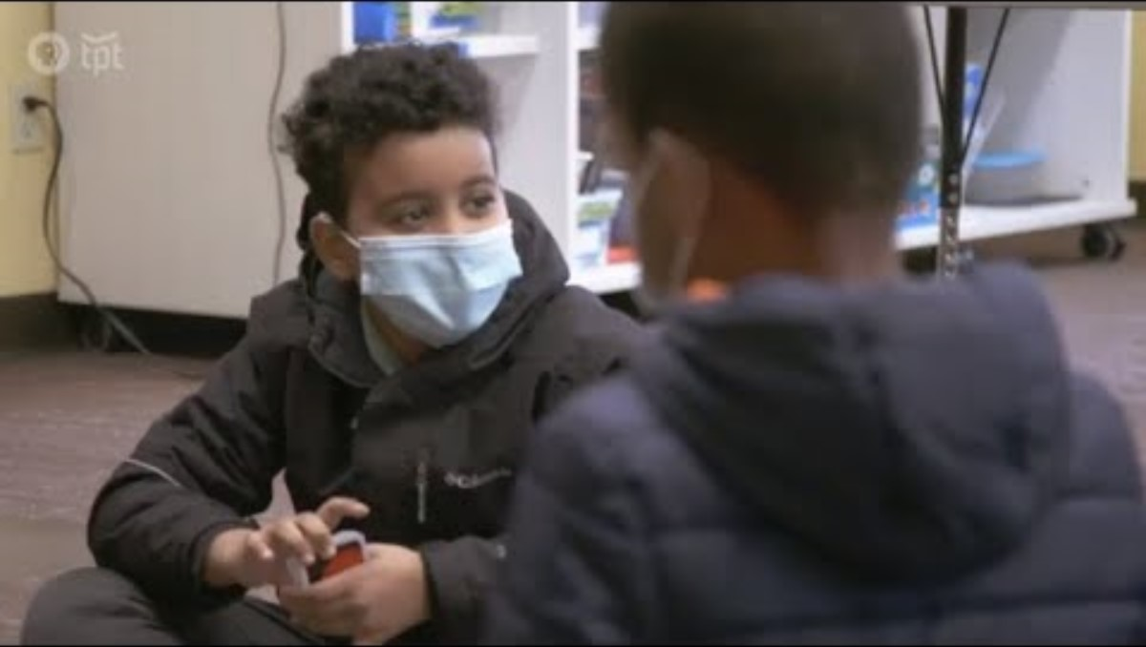

Slide 12


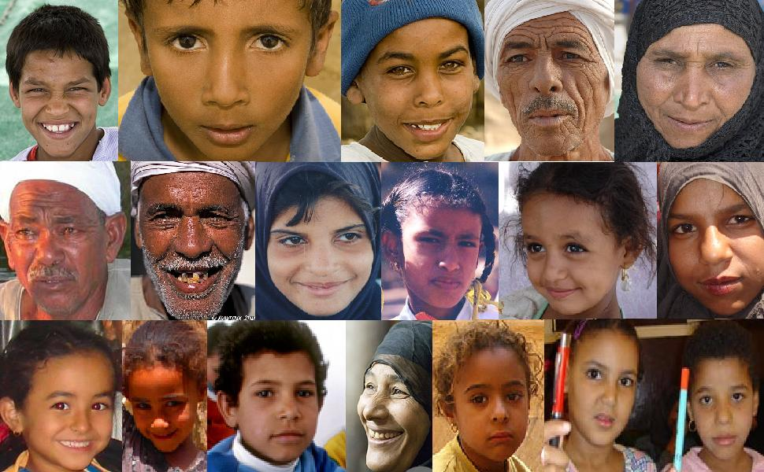
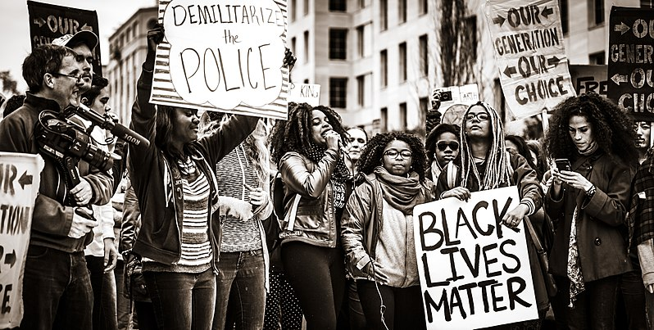
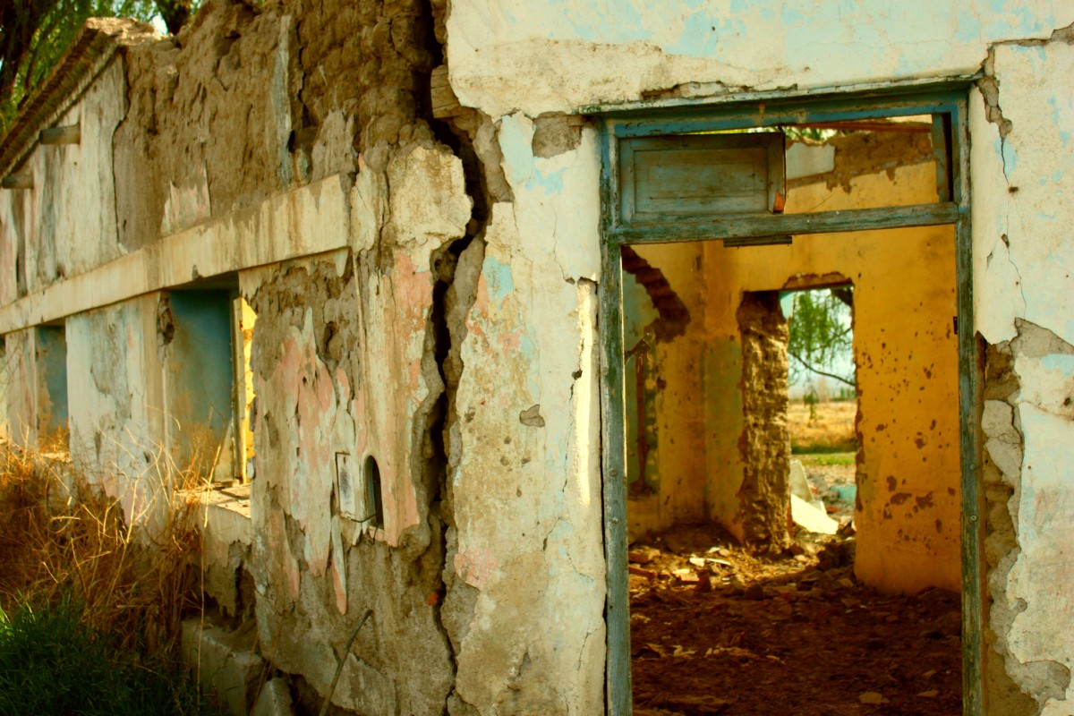


Major Causes of Food Insecurity
LACK OF AFFORDABLE HOUSING
UNEMPLOYMENT
ETHNICITY
RACE
POVERTY
LACK OF INCOME
DISABILITY
https://health.gov/healthypeople/priority-areas/social-determinants-health/literature-summaries/food-insecurity
This Photo by Unknown Author is licensed under CC BY
This Photo by Unknown Author is licensed under CC BY-SA
Notes:
Qulina -

Slide 13




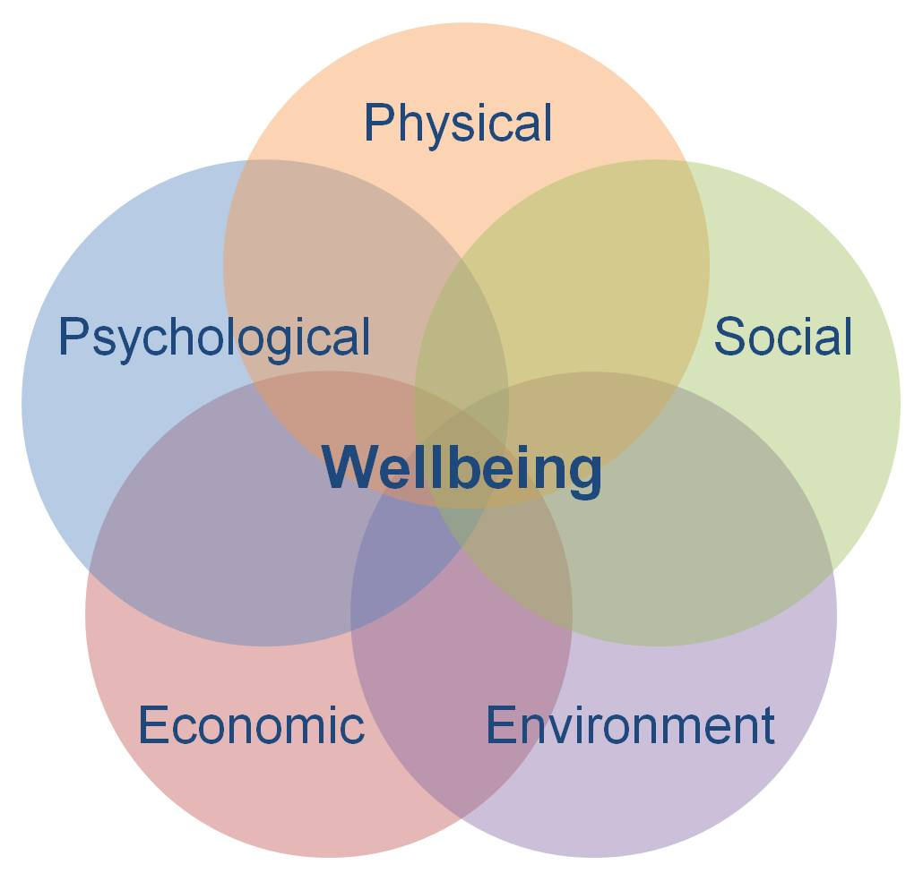
EFFECTS OF FOOD INSECURITIES:
Depression, Anxiety, and Stress
Malnutrition and Chronic Conditions as Heart Disease and Diabetes
Difficulty concentrating and Loss of energy which may cause social changes and miss work and/or school
Social Isolation, Stigma, Shame
Notes:
Qulina - Food Insecurity is a root cause for Health Disparities. It harms our health, nutrition, productivity, and well-being.
It is associated with a higher possibility of chronic diseases as hypertension, hepatitis, stroke cancer, asthma, diabetes, arthritis, coronary artery disease, chronic obstructive pulmonary disease, and kidney Disease
According to a study in 2019, it adds $53 billion annually to preventable healthcare costs.

Slide 14
5 Short Term Affects of Food Insecurity on Kids:
MALNOURISHMENT
FATIGUE
BEHAVIOR ISSUES
EMBARRASMENT/SHAME
POOR PERFORMANCE IN SCHOOL
https://thesnacksack.org/post/part-1-5-short-term-effects-of-food-insecurity-on-kids
Notes:
Qulina – THIS SLIDE TALKS ABOUT THE 5 SHORT TERM AFFECTS ON KIDS
These affects are very similar in adults.
Not getting enough nutrients results in a kid’s growing brain and body to get what it need to make it through the day.
A hungry child is tired, and exhaustion does not allow the body to be active. It is hard to concentrate and have energy to play.
Hunger is also associated with depression, anxiety, aggression and attention disorders.
Similar to adults, kids with food insecurity feel shame and embarrassment.
When the body is hungry it makes the ability to concentrate and learn, more difficult
A Video is next

Slide 15
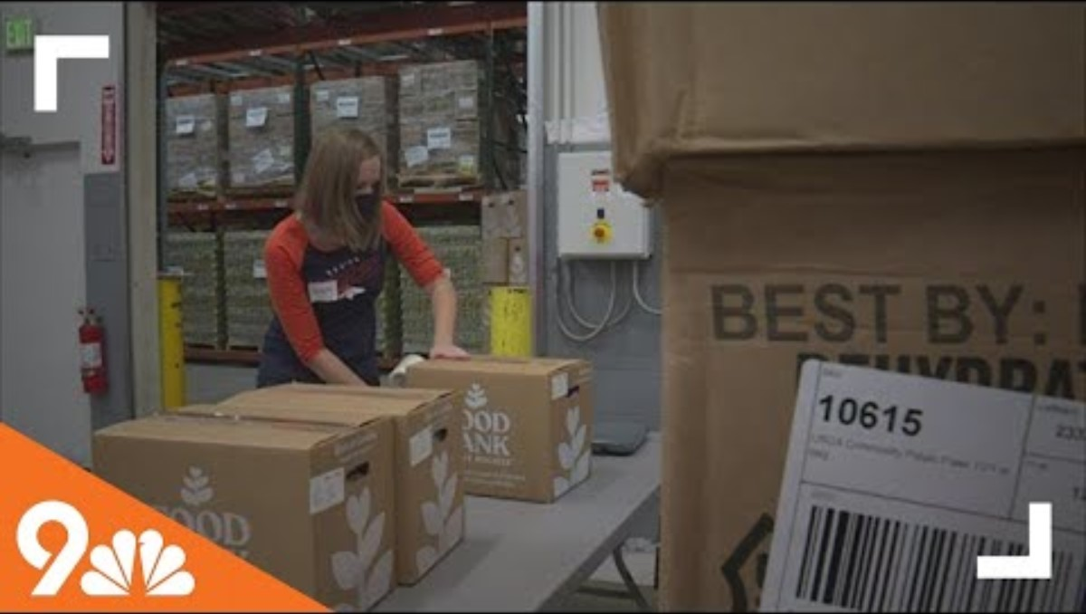

Slide 16
4 Levels of Food Insecurity
HIGH FOOD SECURITY
No problems or limitations related to food access or availability
MARGINAL FOOD SECURITY
Concern that food will run out before being able to afford more
LOW FOOD SECURITY
Reduced quality, variety, or desirability of food intake
FOOD INSECURE
VERY LOW FOOD SECURITY
Disrupted eating patterns resulting in reduced food intake
FOOD INSECURE
https://foodbank.msu.edu/snap/what-is-food-insecurity.html
Notes:
Qulina – here is another slide that also defines the levels of food security

Slide 17
Food Insecurity screening is becoming a Federal Requirement for Health Systems!
Notes:
Qulina – Read the slide first;
This is a vital step toward addressing this problem.

Slide 18
The Joint Commission
(quality inspectors for more than 22,000 healthcare organizations and programs) Has new health equity requirements that include screening for health-related social needs, making it mandatory for ambulatory healthcare, behavior healthcare, human services, critical access to hospitals, and hospital accreditation programs.
Centers for Medicare & Medicaid Services has an inpatient quality reporting program requiring many hospitals to report how many patients were screened for five social determinates of health (SDOH) domains, including food security and how many people screened positive for any of the five domains.
Notes:
Qulina -

Slide 19
Community Health Centers (CHCs) and Federally Qualified Health Centers (FQHCs)may be where these screening are done and where clients receive care.
They are non-profit, community directed organizations designed to serve as the main primary and preventative care provider for millions of people in over 10,000 medically underserved communities across the United States.
Notes:
Estella -

Slide 20
CHCs are federally mandated
They offer comprehensive services based on community needs (i.e. medical, dental, vision, behavior, employment services, housing asst., opioid use treatment etc.)
They are positioned in medically underserved regions
They can not deny client’s care/services based solely on their insurance status or ability to pay. They must offer a sliding scale pay based on a client’s income.
At least 51% of the governing board must be members of the CHC’s key population.
Notes:
Estella – Read the slides first:
Ask the CHW’s: Can you see where screening for food insecurity and other resources would help with their comprehensive services?

Slide 21

Here are some of those reasons we have identified.
We also want caregivers to be able to identify these barriers of disclosure:
Embarrassment
Sigma
Fear of loosing children
Shame
Pride
Notes:
Estella – next slide, I will turn it over to Joyce to describe the next activity

Slide 22
What are some reasons that you think patients would not disclose these barriers with their Health Care Provider (HCP)?
Notes:
Estella -

Slide 23
Sample Food In-Security Survey:
In the last 6 months is the following statement often, sometimes, or never true for you: "The food that I bought just didn't last, and I didn't have the money to get more.“
Often True (1 point)
Sometimes True (1 point)
Never True (0 points)
2. In the last 6 months, is the following statement often, sometimes, or never true for you: “I couldn’t afford to eat balanced meals.”
Often True (1 point)
Sometimes True (1 point)
Never True (0 points)
3. In the last 6 months, did you ever cut the size of your meals or skip meals because there wasn't enough money for food?
Yes (1 point)
No (0 points)
3. If you answered “Yes” to the previous question, how often did this happen?
Almost every month (1 points)
Some months but not every month (1 points)
Only 1 or 2 months (0 points)
4. In the last 12 months, did you ever eat less than you felt you should because there wasn't enough money for food?
Yes (1 points)
No (0 points)
5. In the last 12 months, were you every hungry but didn't eat because there wasn't enough money for food?
Yes (1 points)
No ( 0 points)
Notes:
Joyce - On your tables you each should have a copy of this survey; this is an example survey that is being used to assess a client/patient’s need for help with food. Now we are going to do a group table activity and have everyone practice filling out the survey. Then we will tally your score and have an open discussion. I will give everyone 10 mins.

Slide 24
Add your total below to determine your Clients/patients level of food security:
Score 0: High food security
Score 1: Marginal food security
Score 2-4: Low food security
Score 5-6: Very low food security
**U.S Household Food Security Survey Module: Six-Item Short Form created by the Economic Research Service of the USDA.
Notes:
Joyce - Use your survey and tally your scores on this sheet that is also on your table, we will use about 5 mins to tally.
Can you see how the screen sheets work ?

Slide 25
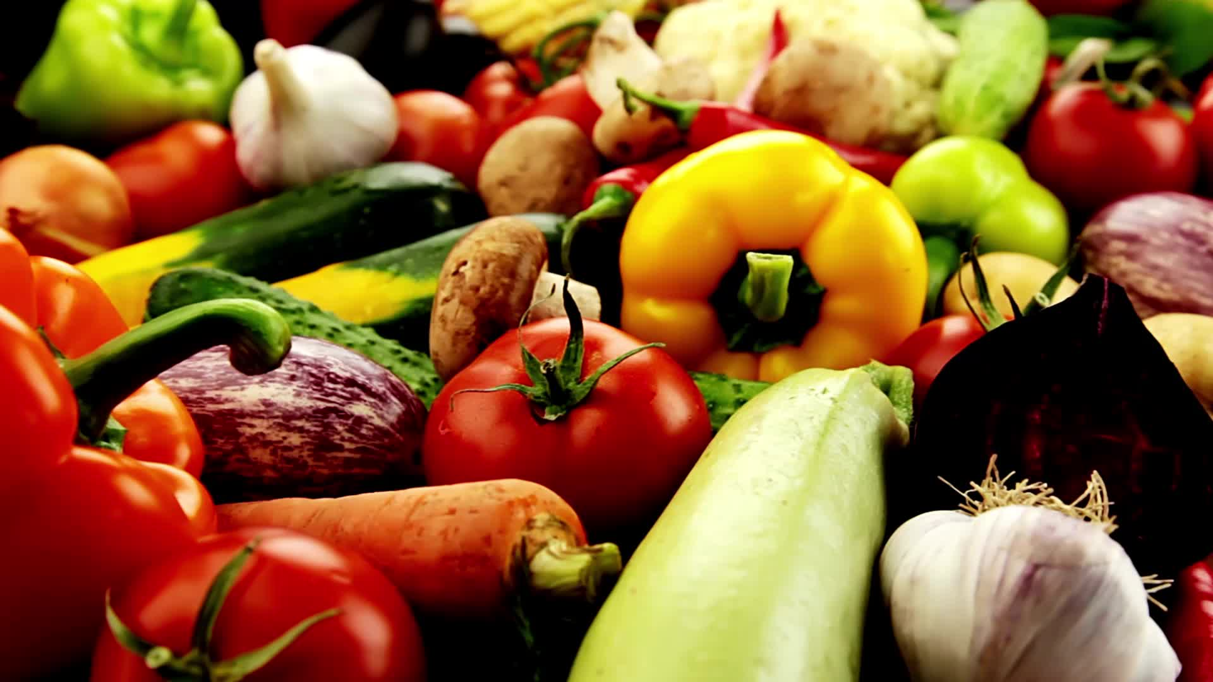

USDA data shows In 2020, 38.3 million people lived in food in-secure households.
Notes:
Estella -

Slide 26
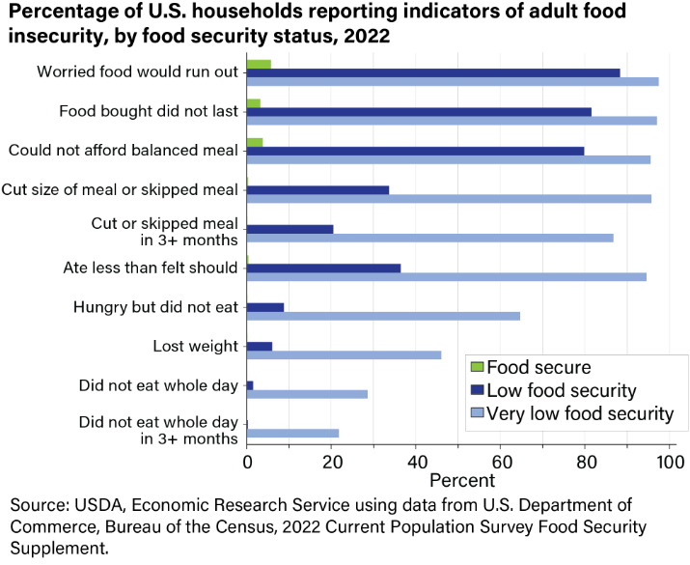
Notes:
Estella - 98 percent reported having worried their food would run out before they had money to buy more.
97 percent reported the food they bought just did not last, and they did not have money to get more.
96 percent reported they could not afford to eat balanced meals.
96 percent reported an adult had cut the size of meals or skipped meals because there was not enough money for food; 87 percent reported this had occurred in 3 or more months.
95 percent reported they had eaten less than they felt they should because there was not enough money for food.
65 percent reported they had been hungry but did not eat because they could not afford enough food.
46 percent reported having lost weight because they did not have enough money for food.
29 percent reported an adult did not eat for a whole day because there was not enough money for food; 22 percent reported this had occurred in 3 or more months.

Slide 27
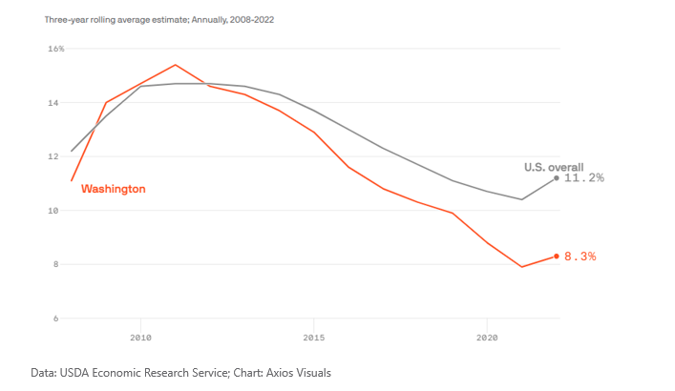
Share of Washington households that are food insecure
The number of Americans who couldn't reliably afford to eat is rising, both in Washington state and around the country, according to new government data.
Notes:
Estella - Across Washington, an average of 8.3% of households were living with food insecurity between 2020 and 2022, compared to 7.9% from 2019 to 2021.
Before the pandemic, Seattle-based Food Lifeline was serving up to 700,000 people in the region annually
But that number swelled during the pandemic to 1.1 million and has since grown to a staggering 1.6 million.
Rising food costs since the pandemic is currently one of the biggest drivers of food insecurity in Western Washington,
Nationally, the share of households that couldn't reliably afford food rose from 10.2% in 2021 to 12.8% in 2022, according to the U.S. Department of Agriculture's economic research service.
Among households with children, 17.3% are food-insecure, this is up nearly 5 percentage points from the previous year. The last time that number was higher was in 2014.

Slide 28
Low-income households in Washington State are still struggling with food insecurity as programs were put into place during the pandemic coming to an end.
Affording food is such a huge challenge in Washington State, residents experiencing food insecurity say their grocery bills are their biggest source of financial stress, even more than paying for rent and/or utilities.
https://nutr.uw.edu/news/low-income-washington-state-households-still-struggling-with-food-insecurity-as-pandemic-protections-end/
Notes:
Estella -

Slide 29

These are the results of a study on households in WA State when the pandemic resources ended, and households faced food insecurities
5,052 Responses representing all of Washington
About 41% of people have household incomes of $35.000 or less and 71% have incomes of $75.000 or less
49% experienced food insecurity in the past month and 55% used food assistance in the past month
Food insecurity was higher in those identifying as non-Hispanic Black (47% reported very low food security)
Hispanic 34%. Other race/ethnicity 34%, which includes American Indian or Alaskan Native, Native Hawai’ian or other Pacific Islanders and self-described race/ethnic identities
https://nutr.uw.edu/news/low-income-washington-state-households-still-struggling-with-food-insecurity-as-pandemic-protections-end/g
Notes:
Estella – Read the heading, then read this notes: Researchers found, people are not just having trouble affording food, but are also unable to afford healthy foods. People experiencing food insecurity changed what and where they ate.
Food insecurity was also experienced more in residents who rent or have other living arrangements as compared to those who owned homes.
Of all households experiencing food insecurity, 77% reported “not getting by” or “barely getting by” and over half expressed that food price increases were very stressful.

Slide 30
5 Dimensions of Food Access
AVAILABILITY
ACCESSIBILITY/CONVENIENCE
AFFORDABILITY
ACCOMODATION
ACCEPTABILITY
Adapted from the Healthy food availability Bank Network Report 2019
Notes:
Estella – read the heading first: then give definition
Availability – adequate supply of healthy culturally appropriate food.
Accessibility - geographic location of food and ease of getting to that location.
Affordability – food prices and people’s perception of worth relative to cost and quality.
Accommodation – food retailers meet the needs of the community members.
Acceptability – attitudes regarding characteristics of the food environment.

Slide 31
Social Determinants of Health as well as Food Access are Influenced by Inequitable Distribution of Wealth, Social, Economical, and Political Power!
Notes:
Estella – after you read the slide, Say: I will now turn it over to Joyce

Slide 32
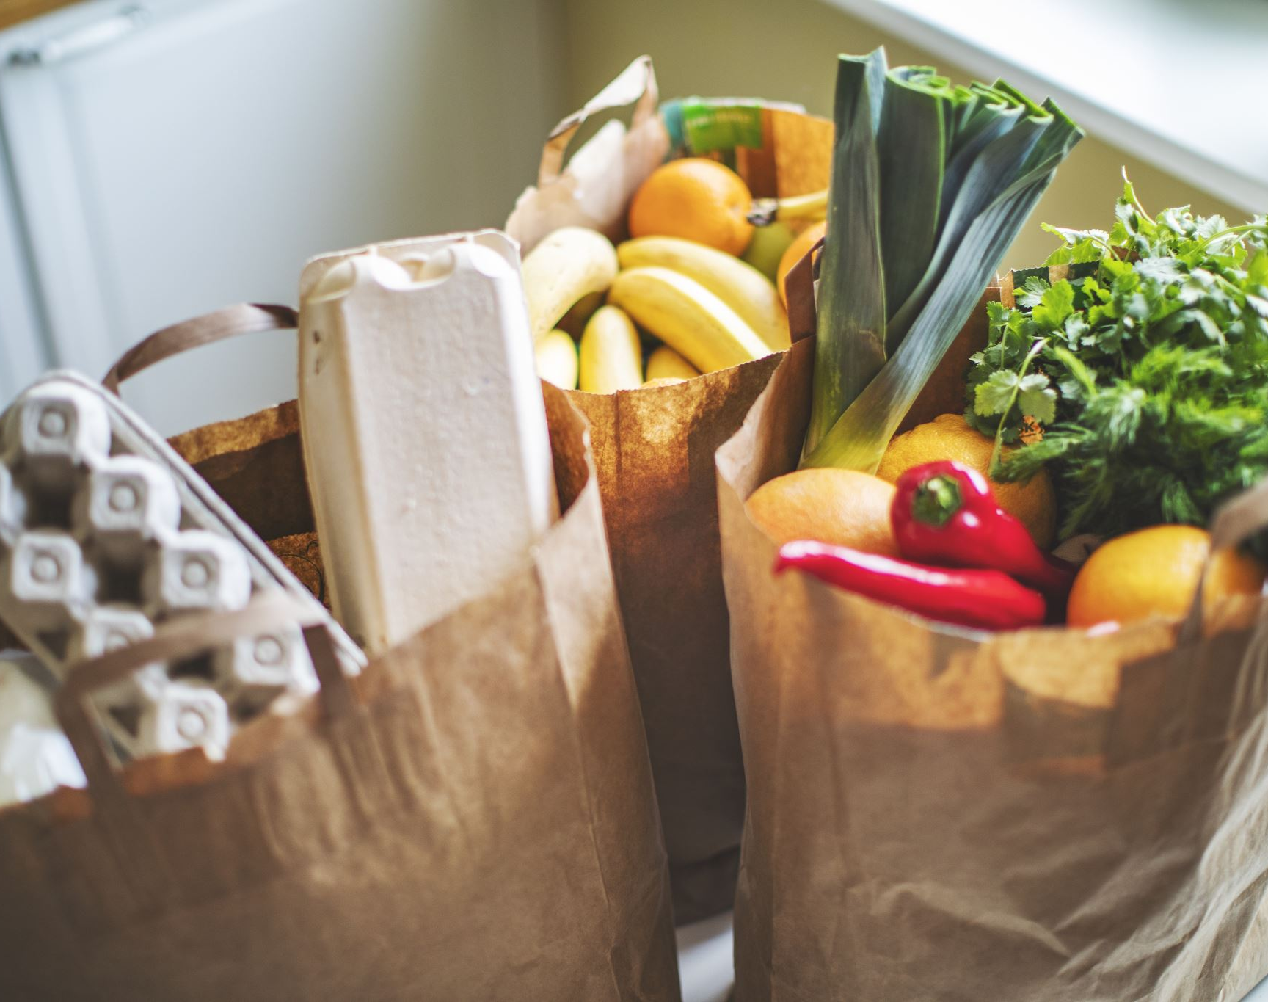
Federal data shows the dilemma of affording healthy food and having access to a grocery store that sells that food isn't an equitable dilemma. Black, Hispanic and other people of color have higher rates of food insecurity than white people.
Notes:
Estella – read the slide
And the plan would be that we break for lunch, but we will access the agenda.

Slide 33
Take a look at the next video:
What did you notice went well in the interaction?
Are there things you would have done differently?
Notes:
Estella – take a look at the next video: while watching it, what did you notice went well in the interaction, and are there things you would have done differently ? Allow 1 or 2 folks to share out:

Slide 34


Slide 35
When having conversations with clients about Food Insecurity:
Describe food insecurity as system failures rather than individual failures.
Have these conversations in private.
(not in front of others)
Notes:
Estella – read slide

Slide 36
●Ask Open Ended Questions
●Be mindful of your Non-Verbal Communication (Body Language)
Notes:
Estella - Why is it important to have open ended questions?
What are some examples of open-ended questions?
What do you think we mean when we say: be mindful of your Non-Verbal Communication?
How is your posture? Are you making eye contact while you are speaking? Are you giving them your full and undivided attention?

Slide 37
Be Culturally Sensitive When Having Conversations
1
Have Empathy
2
Avoid using Deficit Based Language, Be Empowering
3
Notes:
Estella - read the slide

Slide 38
Be Informed and Unbiased
Be Equitable In All Things You Do and Conversations
Notes:
Estella - read the slide. Next I will turn it over to Joyce to share another role play with the survey example

Slide 39

Role Play/Discussion At Tables and Group Sharing
Notes:
Joyce – here we will take about 10 mins to role play. 2 in a group
1 will be the CHW and 1 the client (you are going do a mock visit) and ask your client to fill out the survey.

Slide 40
Another Sample Food Insecurity Survey:
During the last 12 months, was there a time when, because of lack of money or other resources:
You were worried you would not have enough food to eat?
You were unable to eat healthy and nutritious food?
You ate only a few kinds of foods?
You had to skip a meal?
You ate less than you thought you should?
Your household ran out of food?
You were hungry but did not eat?
You went without eating for a whole day?
Notes:
Joyce – on your tables you should have this sheet; I will give you a few mins to review.

Slide 41
The Food Insecurity Experience Scale (FIES)
The Global Reference Scale:
You were worried you would not have enough food to eat?
You were unable to ate healthy and nutritious food?
You had to skip a meal?
You were hungry but did not eat?
You went without eating for a whole day?
You ate only a few kinds of foods
You ate less than you thought you should?
Your household ran out of food?
https://fao.org/in-action/voices-of-the-hungry/files/en/
Notes:
Joyce - The FIES global reference scale is based on results from the application of the FIES survey model in countries covered by the Gallup World Poll in 2014, 2015, and 2016, Food insecurity rates from different countries can be made comparable by calibrating them against global reference.
Responses to the questions must always be analyzed together as a scale, not as separate items.

Slide 42
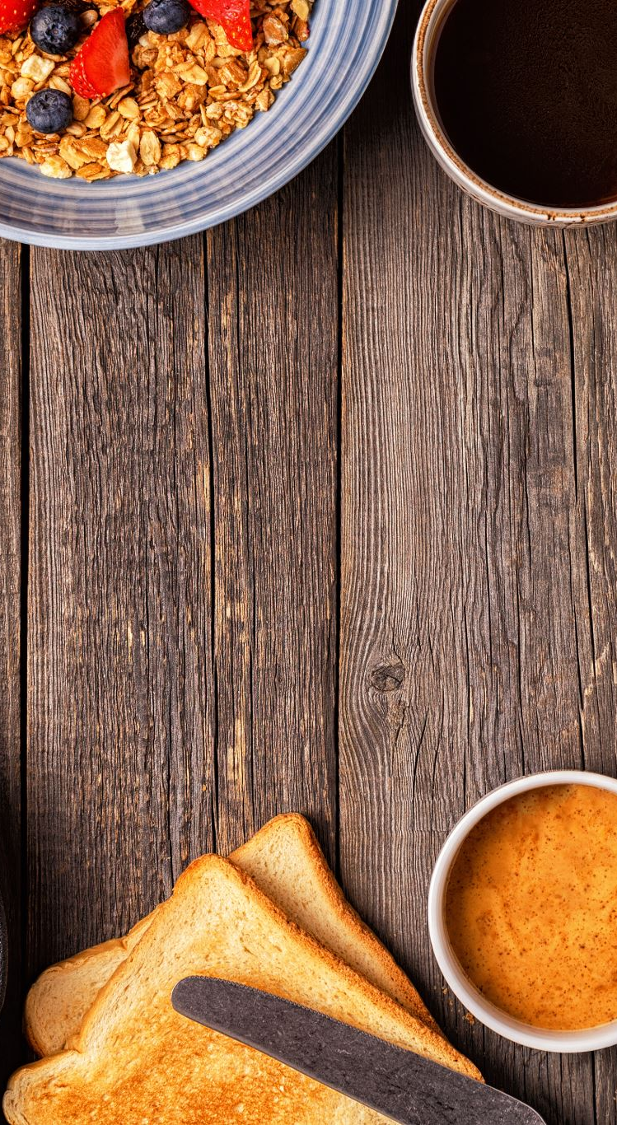
There are resources available to families needing food assistance that they may not know about:
The Supplemental nutrition Assistance Program (SNAP)
The Special Supplemental Nutrition Program for Women, Infant, and Children (WIC)
Afterschool and summer meals, childcare meals, school breakfast, and lunch programs
Other food and nutrition resources such as medically-tailored meals, medically-tailored groceries, produce prescription programs, food pharmacies, food banks, food pantries as available, and if appropriate
Notes:
Qulina - Read slide first.
These programs are not all related and not all associated with DSHS.

Slide 43
Work Cited
9News. (2023). How Food Insecurity Affects Mental and Physical Health. Retrieved from YouTube: https://youtube.com/results?search_query=how+food+insecurity+affects+menta+and+physical+health
Kutch, B. M. (2020, 10 30). Part 1: 5 Short-Term Effects Of Food Insecurity On Kids. Retrieved from The snack sack: https://thesnacksack.org/post/part-1-5-short-term-effects-of-food-insecurity-on-kids
Matthew P. Rabbitt, L. J.-J.-J. (2023, 10 25). Definitions of Food Security. Retrieved from United States Department Of Agriculture: https://www.ers.usda.gov/topics/food-nutrition-assistance/food-security-in-the-u-s/definitions-of-food-security/
Michigan, B. C. (n.d.). What is food insecurity and why is it a problem? Retrieved from YouTube: https://youtube.com/results?search_query=food+insecurity
MSU Student Food Bank. (n.d.). Retrieved from Michigan State University.
Office of Disease Prevention and Health Promotion. (n.d.). Retrieved from U.S. Department of Health and Human Services: hhtps://health.gov/healthypeople/priority-areas/social-determinants-health/literature-summaries/food-insecurity
Sheward, A. A. (2023). What Anti-Hunger Advocates Need To Know About Food Insecurity and Other Health Related Social Needs. Hunger Vital SIgn Nation Community of Practice.
Stringer, K. (2023, 2 22). News and Events. Retrieved from WA Schhol of Public Health Food Systems, Nutrition, And Health: https://nutr.uw.edu/news/low-income-washington-state-househods-still-struggling-with-food-insecurity-as-pandemic-protections-end/
The Food Insecurity Experience Scale. (2023). Retrieved from Voices of Hungry: https://fao.org/in-action/voices-of-the=hungry/fies/en/
Notes:
Joyce – these are the work cited links that we retrieved our information from, along with King County and SKC food coalition.
At this time, I am going ask that everyone please fill out your feedback forms and leave them on the table.

Slide 44

QUESTIONS??
Notes:
Joyce -

