Slide 1


Slide 2



Social Service Coordination
Community
Network Council
Notes:
Introductions /Land acknowledgment

Slide 3
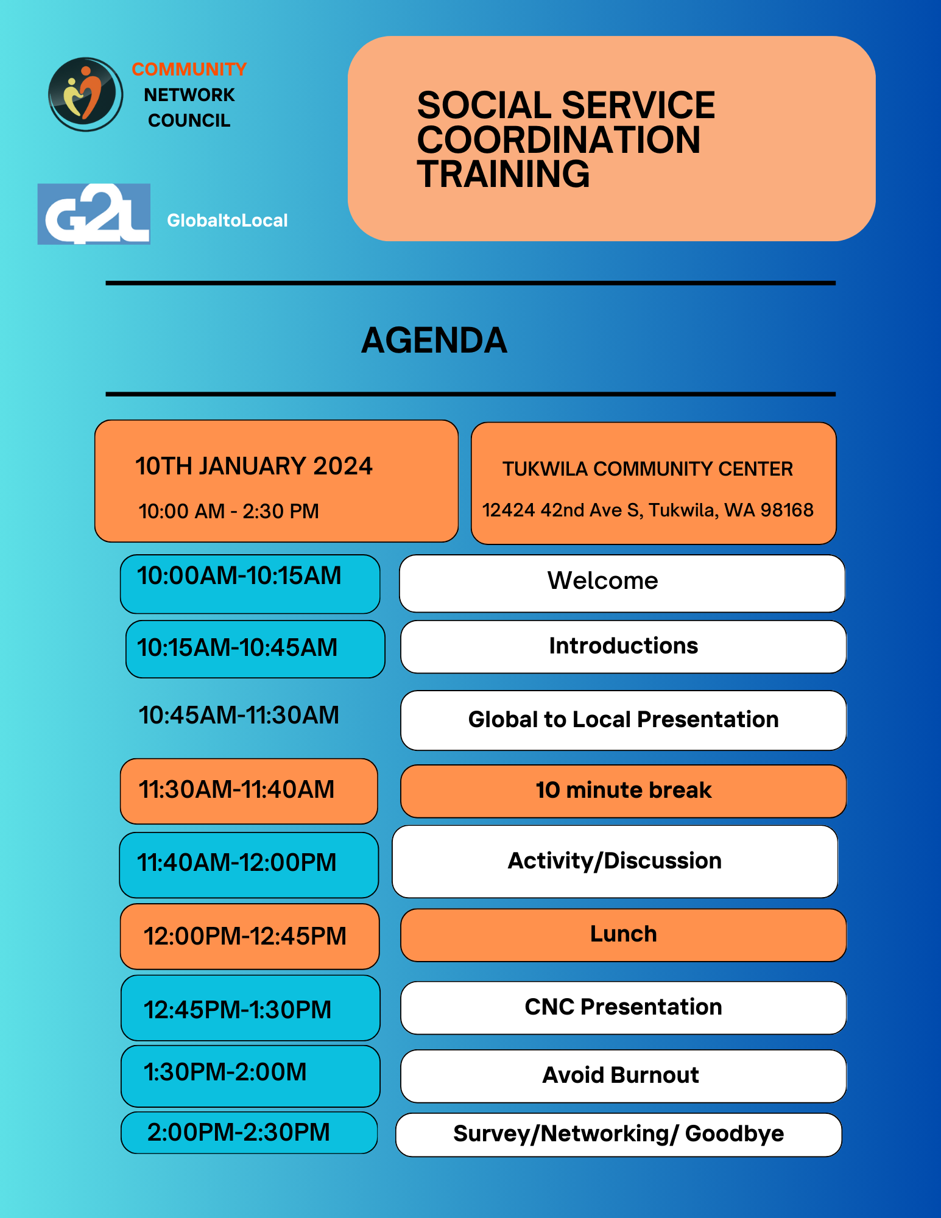
Notes:
go over housekeeping

Slide 4
Learning Objectives
Define Social Service
Whole Person Care
Understand the Different Type of Social Services Resources
Connect to Community network Council
Avoid Burnout

Slide 5

Agreements
Stay Engaged
Be Respectful
Listen to others
Be Kind
Have Fun!!

Slide 6

Introduce yourself to your table
What is your name ………
where do you work? and what are you excited for this summer?
Ice breaker activity .
Notes:
where everything is located
Blind Drawing activity 10min

Slide 7

Presenting Global to Local
Advancing health equity and building community power in South King County,
Enhancing your presentation

Slide 8

About our CHW Program
Notes:
3 people share share your mission statement or values . and why that is important .

Slide 9
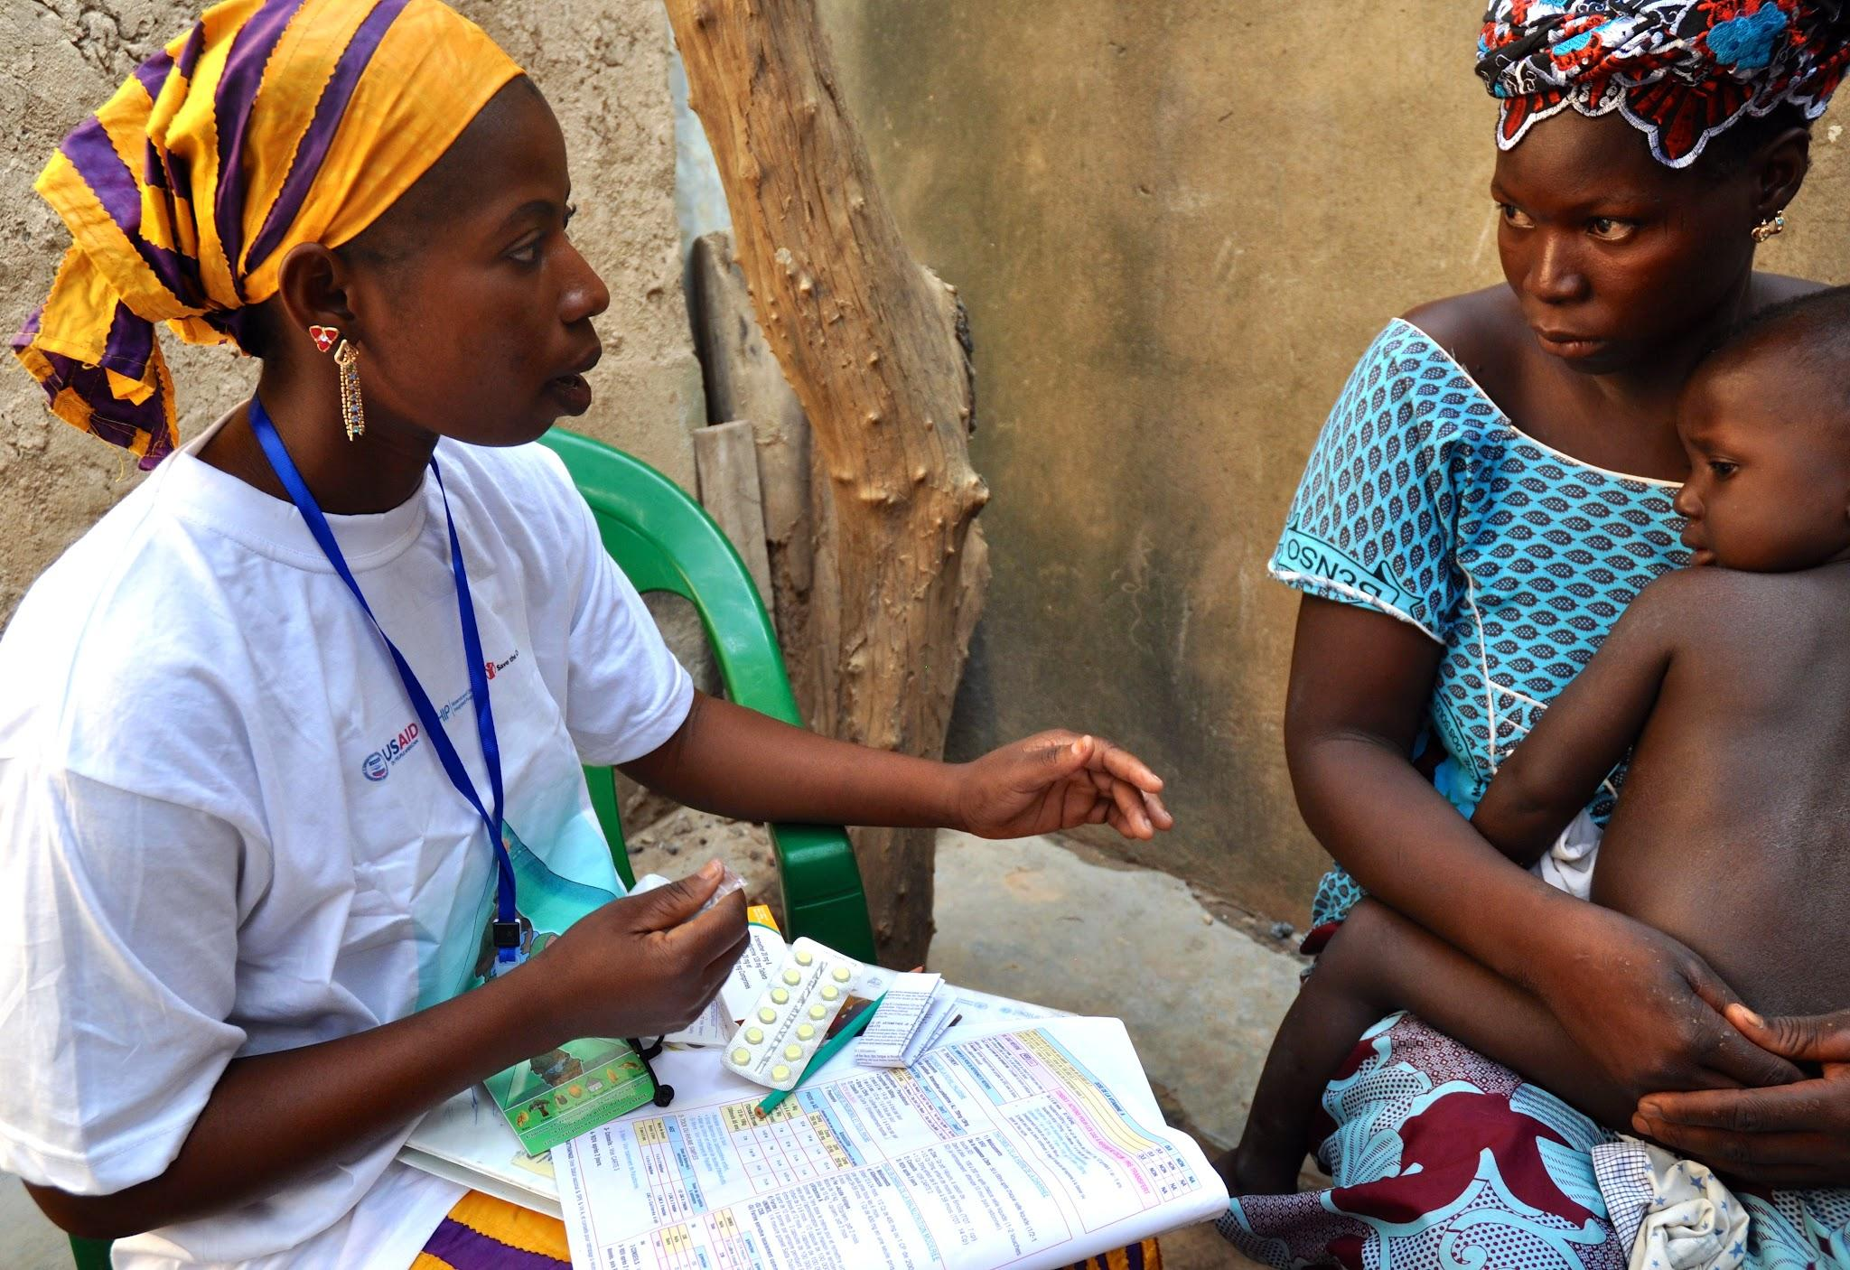

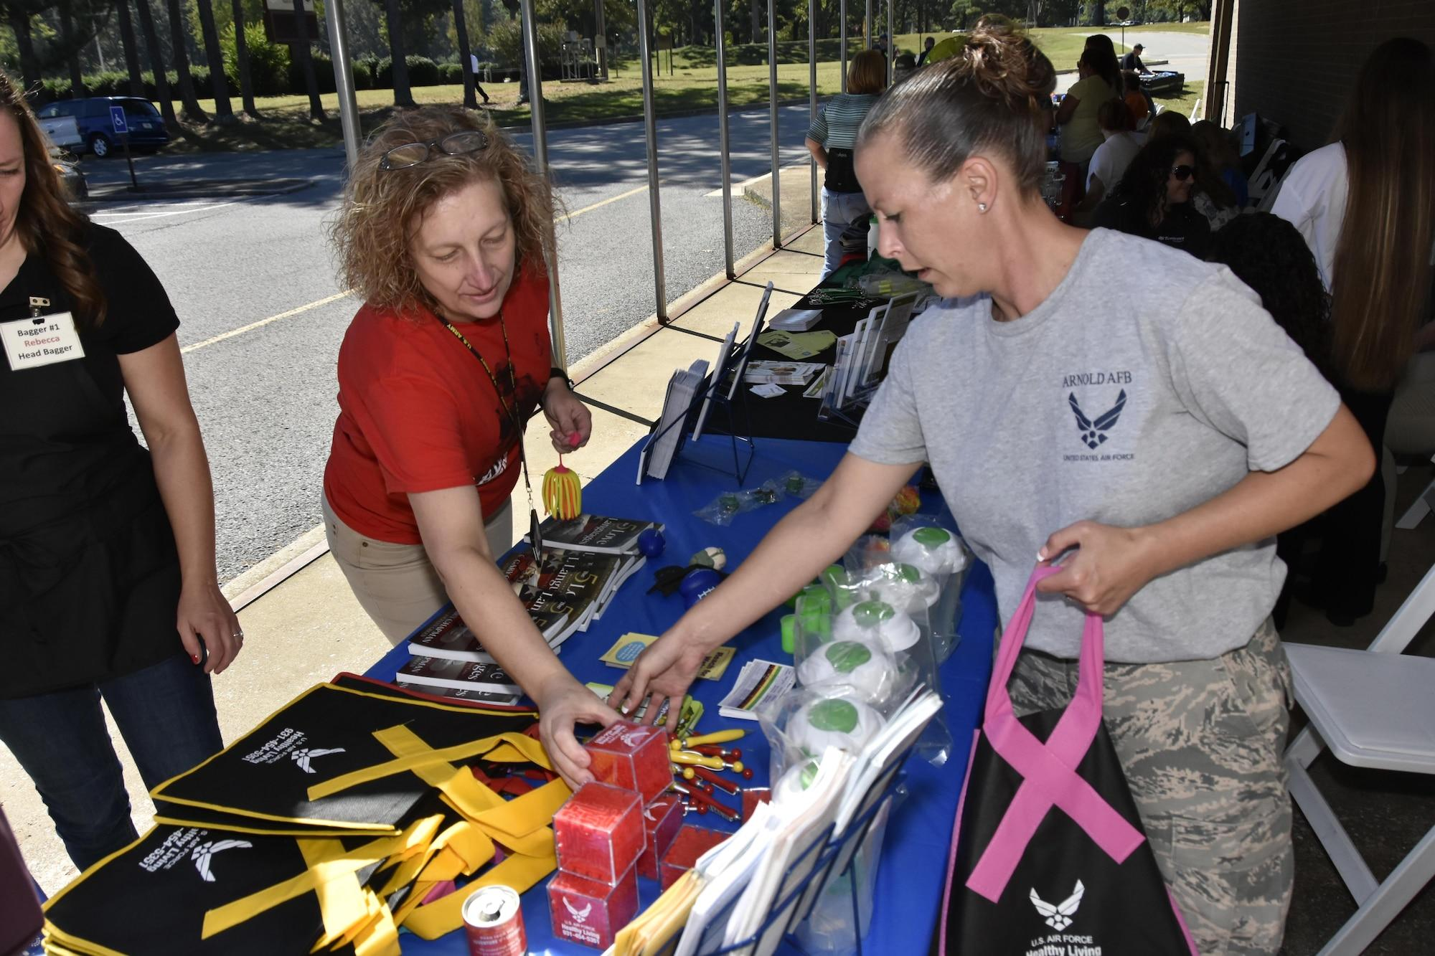
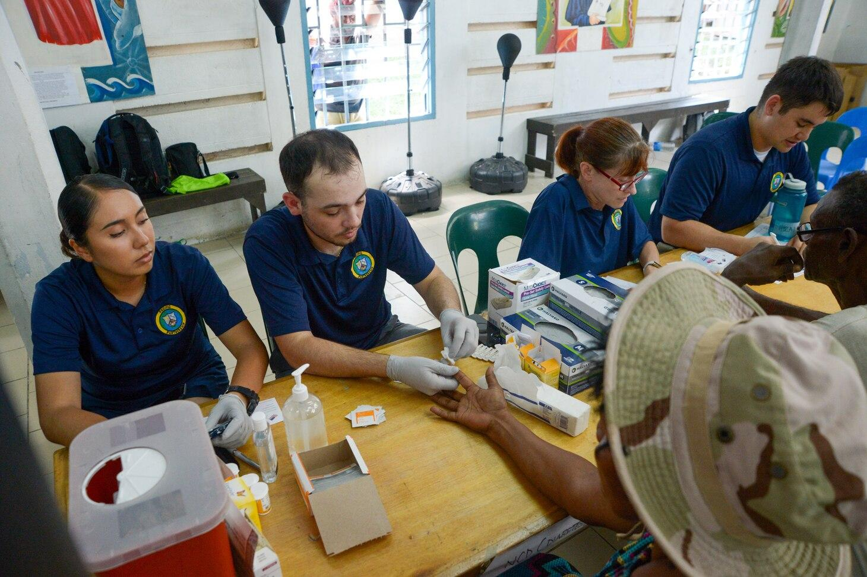
Social Service
Social Service is any of numerous publicly or privately provided services intended to aid disadvantaged, distressed, or vulnerable persons or groups. Programs and services that improve the wellbeing of individuals and communities.
Notes:
How do you coordinate services for clients?

Slide 10
How do social determinants impact the public’s health?
https://youtu.be/utBlfjihvAs
Social determinants of health (SDOH) refer to the conditions in which people are born, live, learn, work, play, worship, and age, which can impact a wide range of health outcomes and risks. Global to Local team of Community Health Workers (CHWs) work to promote health equity in marginalized communities of South King County. through education and advocacy. They work to address social determinants of health, assisting community members in accessing quality healthcare services, achieving economic stability, accessing quality education, quality neighborhoods, and built environment, and social and community context.

Slide 11
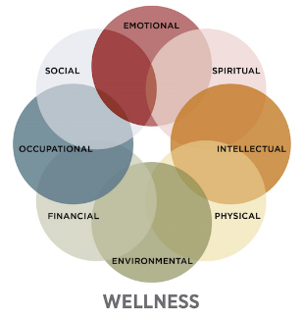
What is whole person Care?
Whole person health involves looking at the whole person—not just separate organs or body systems—and considering multiple factors that promote either health or disease. It means helping and empowering individuals, families, communities, and populations to improve their health in multiple interconnected biological, behavioral, social, and environmental areas. Instead of just treating a specific disease, whole person health focuses on restoring health, promoting resilience, and preventing diseases across a lifespan

Slide 12

S.A.I.L Stay Active and Independent for Life is a King County Project in collaboration with SHAG/CIRC and Global to local .
(SAIL) is a strength, balance, and flexibility fitness program for adults 65 and older, primarily focusing on Fall Prevention. The entire program was designed for any level of ability. This program seeks to serve all seniors, particularly low-income individuals, including immigrants, refugees, and seniors with mobility challenges and chronic health conditions within the Latino and Somali communities.
TESTIMONIALS
“My balance has improved so much that
I am not as afraid to fall again, and I have
learned how to keep myself safe” –M.M. (80)
“This class gets me up and moving, motivated To get out and go. I am stronger and feel great!” – C.R. (89)

Slide 13

Food Innovation Network Program
Our Food Innovation Network (FIN) Program enhances the local food system, increases access to healthy foods, and supports local food businesses in the diverse communities of South King County.
FIN’s core program activities include:
Food Business Incubator at Spice Bridge;
coordination of community meals;
management of the Tukwila Village Farmers Market, including distribution of food access benefits and resources;
advocacy to address policy and regulatory barriers; and outreach to engage communities in food systems change and resource connection.

Slide 14
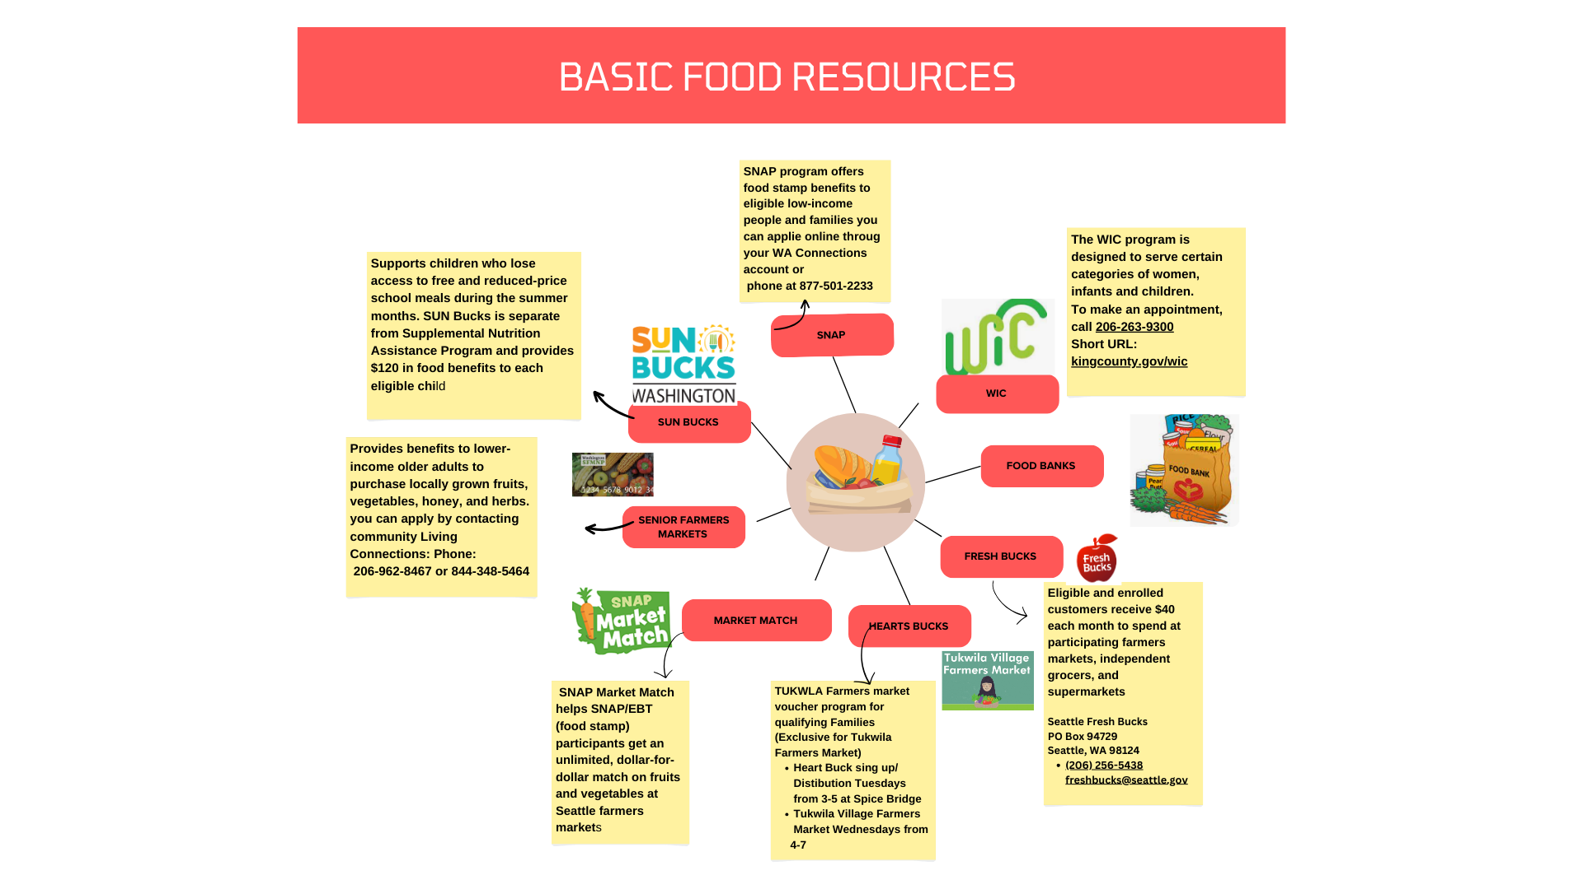

Slide 15
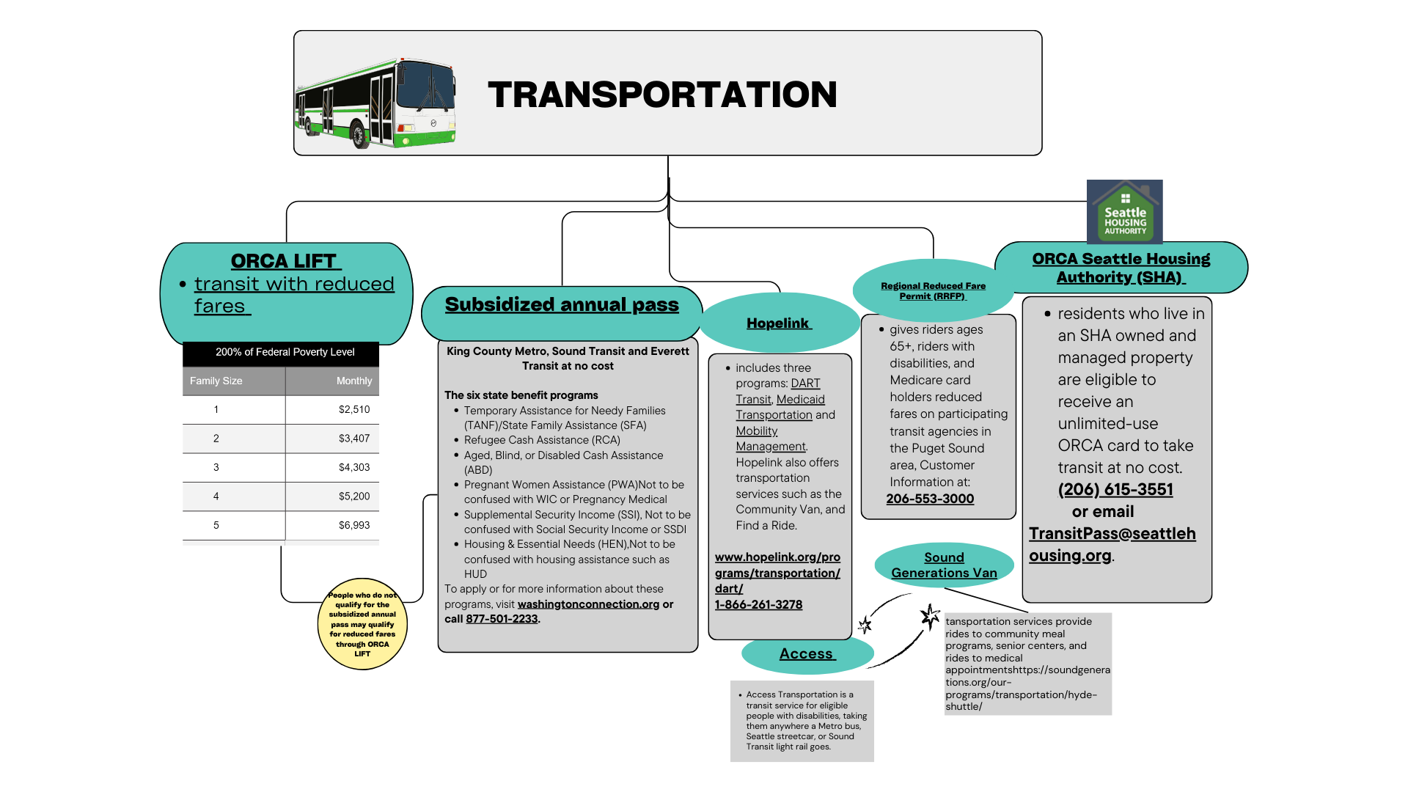

Slide 16
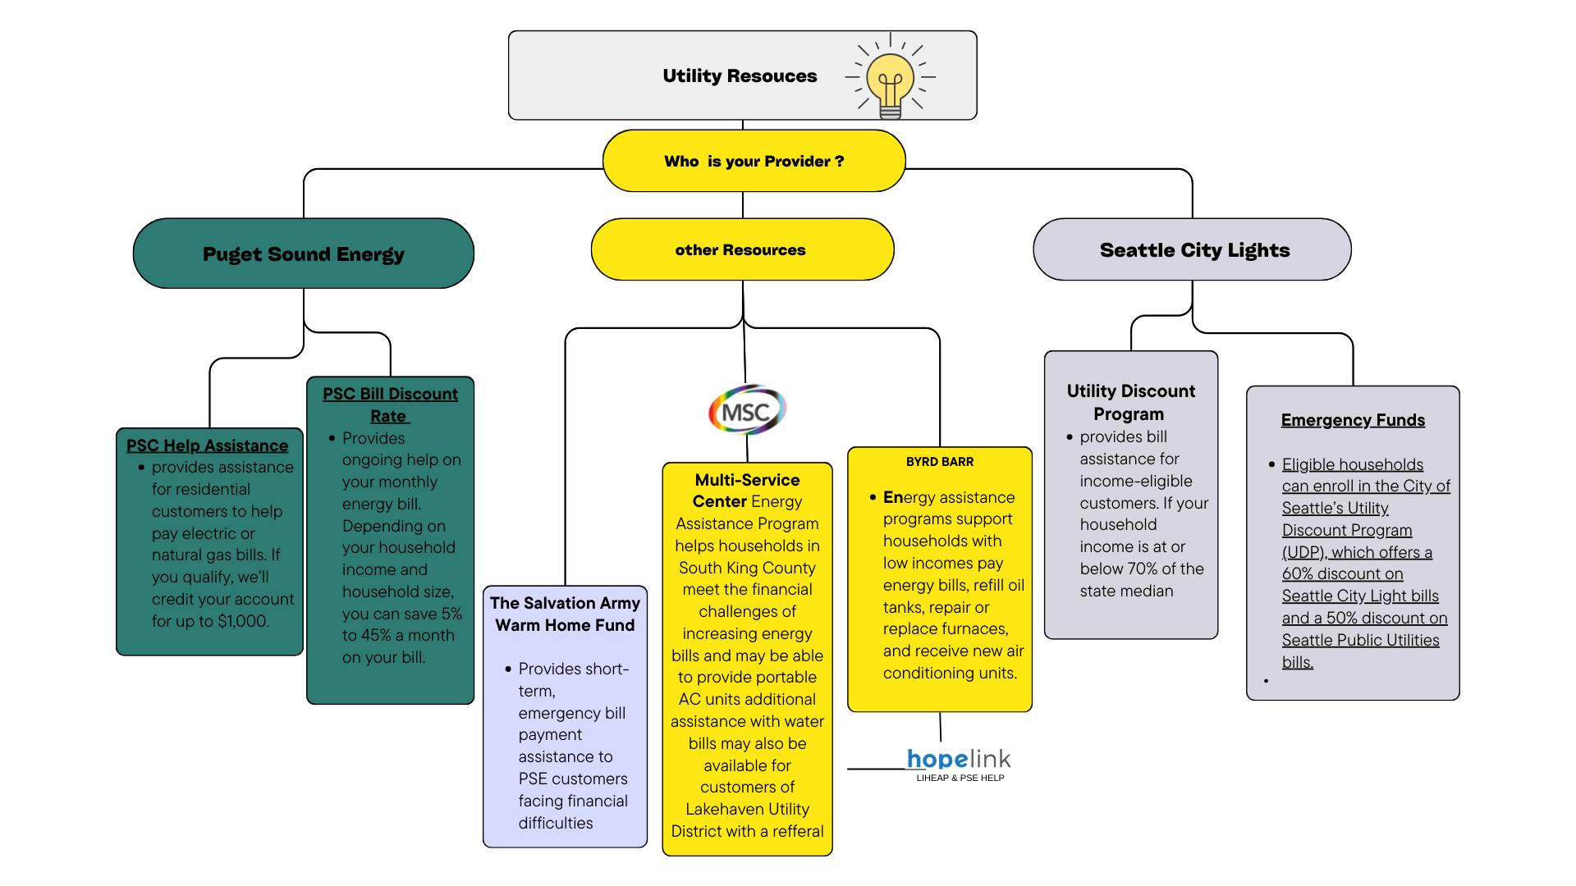

Slide 17
10 minute Break!
Please be Back at 11:40 for Activity and discussion

Slide 18
Case study
In your group Read the case study.
How would you assist this client
What services would you assist this client with .

Slide 19



Community
Network Council
(CNC)
Address: 1819 Central Ave S, Suite 72
Kent, WA 98032
info@wacnc.org
206-349-4071
A501(c) Nonprofit
www.wacnc.org
Notes:
CNC aka Community Network Council is a nonprofit organization based in Kent on 1819 Central Ave S.
We can be reach by email or phone. **Read phone number & email ** . You can visit our website wacnc.org for more in depth detail of CNC’s work and volunteer opportunities.

Slide 20

MISSION: Empowering, Equipping,
Esteeming Our Students
GOAL
Improve high school graduation rates
Connect our youth/ families to resources
Promote Family Engagement
Notes:
CNC is youth-centric collaborative devoted to empowering, equipping , and esteeming students through various programs and tools. Our goal is to **READ GOAL LIST**

Slide 21
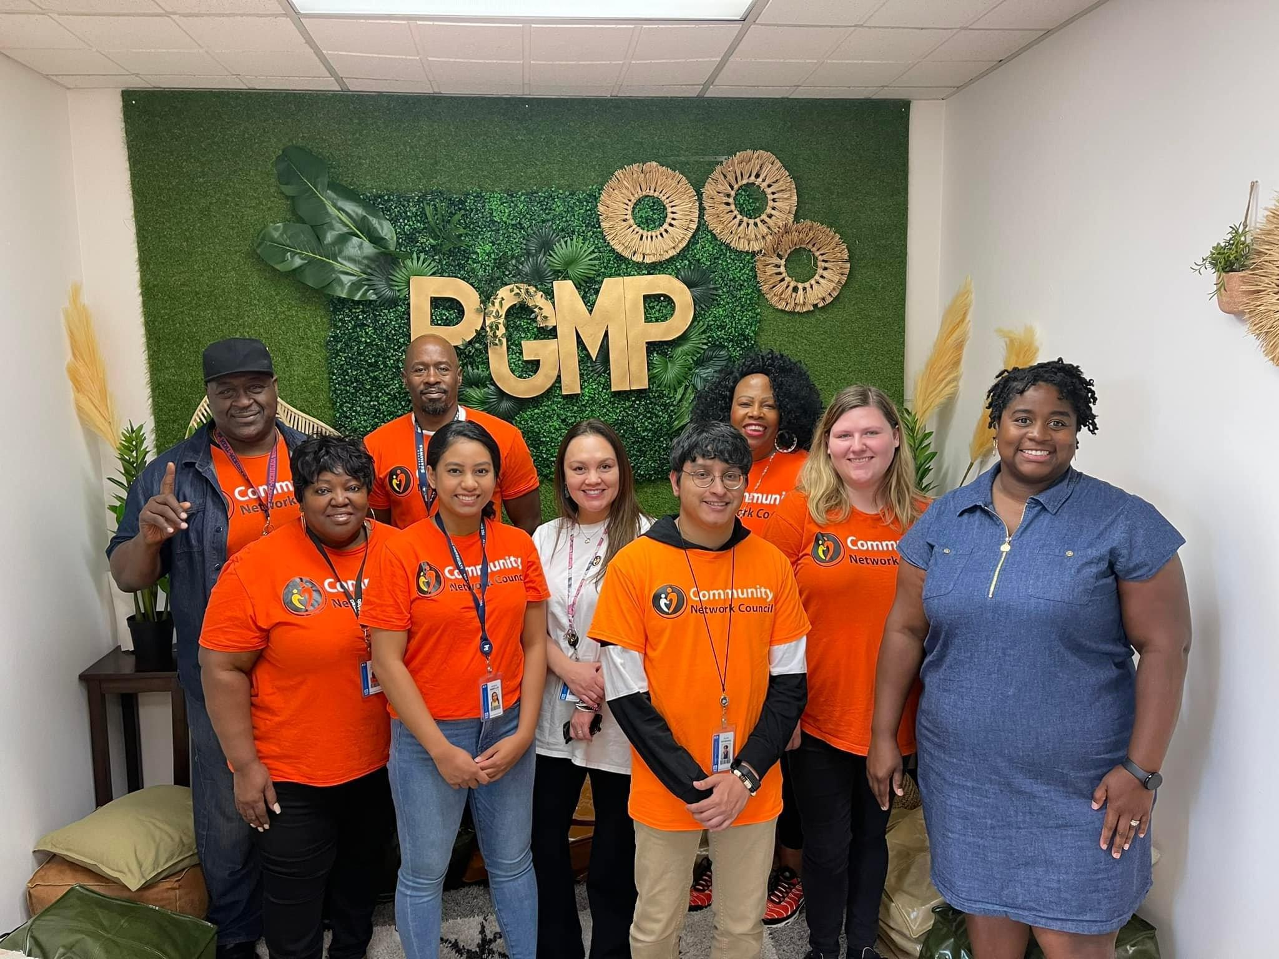
CNC Main Program
Academic Coaches (AC)
ACADEMIC MENTORSHIP based in Kent School District
FAMILY ENGAGEMENT
Notes:
CNC main program is the Academic Coaching Program. The program is based in select schools in Kent School District . The program is made up of a great team of Academic Coaches and a Community Health Worker that works one on one with students and families of color . Our work focuses on building scholars students by addressing students academics, attendance , and behavior. However , our work is not limited to academics. Through additional programs and partnerships we work to increase benefits by sponsoring different programs to bring the community, families, & organizations together, for the purpose of helping our youth.
Community Network Council recognize the importance of family engagement, to increase trust, safety, cooperation, and positive parenting in the community for both children and parents.

Slide 22
Student Testimonials
“CNC helped me as Black student build my confidence in education. It helped me with build a bond I thought I wouldnt be able to build. I don’t think I would have been able to prioritize all the important things in my life, such as education & scholarships since I am in my senior year. Thank you guys for being there for me educationally, & thank you to my academic coach for being there for me in general”. Angel (Student)
My son, Elijah, has made significant changes as a result of this program. His grades are better & his attitude more positive. The opportunity to interact with students & see their improvement has been very beneficial. I feel encouraged & empowered to do more within the community. Looking forward to what the future holds.” Dedrick(Parent)

Slide 23
CNC Additional Programs
THE SCHOLARS MATH PROGRAM
FINANCIAL LITERACY PROGRAM
COMMUNITY HEALTH & WELLNESS
Notes:
The scholars math program focuses on interactive activities that teaches math through engaging math games, for example utilizing a domino's games. The Financial Literacy Program isa partnership with Financial Empowerment Network, what that looks like is a team of financial professional advisor professional are brought out on campus to meet with our students. Where they are given a opportunity to learn about understanding opening bank account, credit scores, credits bureaus, credit cards, interest rates, and budgeting. We would play out scenarios of budgets , for example, you had an “x* amount of income , how would you spend your money, how much would you put into your rent, bills, food. It was really interesting to see how students would often choose to “live at home with parents of option” because they realize the cost of the rent alone takes most of the income. However, it was really beneficial program for them to get an understanding of responsibilities and finances. It’s never too early to encourage our youth to build their financial knowledge.

Slide 24
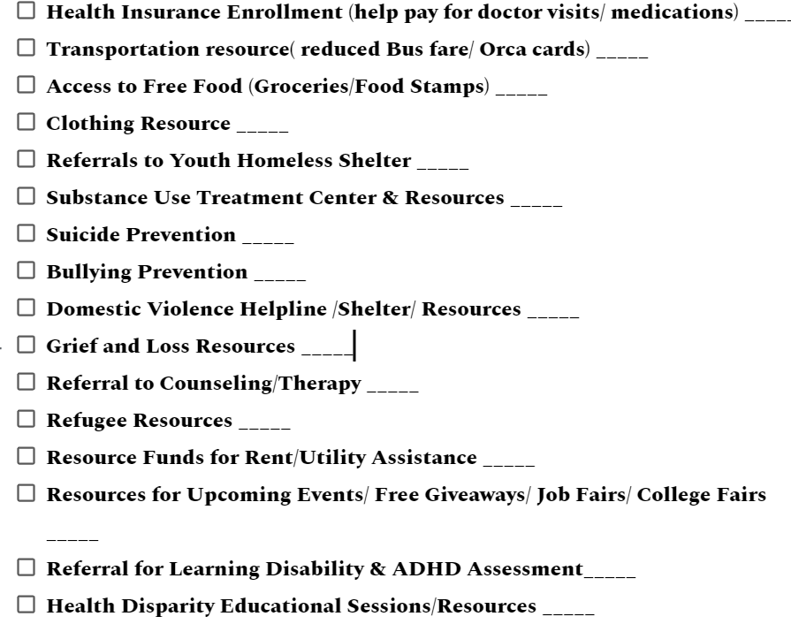
Wishlist Assessment Form
Notes:
The Wishlist Assessment form is a great tool that allows our Academic Coaches and CHWS to work interactively with our students and families. To listen and note their needs, from health insurance, transportations, access to food, clothing, prevention plans, grief and loss resources and more. Clients or students are able to check off what resources they need and rate their top 5 resource priority. This assessment forms allows the CNC team to identify resources in demand and reach out to families one on one to connect them to available resources.

Slide 25
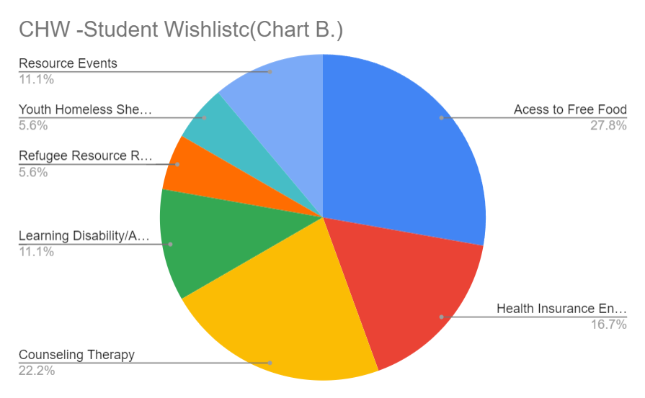
CNC Wishlist Analysis & Referral Process
Notes:
Now I am sharing a visual analysis based off our wish list assessment form.Similar to the purpose of the Wishlist Assessment form, the analysis is about understanding our client’s needs when it comes to social service coordination. We want to be on the same page as a team & being able to analyze our students or clients needs visually. This pie graph is an example of a wishlist analysis collected from our high school students. As you can see majority of the students marked “access to free food” as a top need, 22.2 % chose counseling therapy, 16.7% chose health insurance as a need, 11.1% chose resource events and learning disability resource, and 5.6 % chose youth homeless shelter resources and refugee resources. Analysis is just one of the initial steps of our social coordination process, resource referral is definitely another key component which I am sure it is a term all CHW’s are familiar with. Resource referral is not limited to the roles of the CHW’s, anyone on the team can connect a client to a resource. It is about building that network and communication & utilizing each person’s unique skill and knowledge for the benefit of the client. For example, a client may come to me saying “oh my car is having mechanical issues, but its so expensive to repair it around here. Do you know any good auto shops?” I may never have experienced a auto mechanical issue & I know my go to resource list does not include affordable mechanics. However, I do know my coworker whos is not a CHW, loves cars and was just talking about a buddy who was offering repairs at fair prices. Tadah, I just connected a client to a resource through networking.

Slide 26
Measuring Data
3M
3-6
9-12
12-14
1-3 Month Goal
3-6 Month Goal
9-12 Month Goal
12-14 Month Goal
Parent /Student Anecdotal
Parent /Student Anecdotal
Parent /Student Anecdotal
Parent /Student Anecdotal
Notes:
Circling back to the Academic Coaching Program at CNC. Here at CNC we love to see progress with our students & families and the best way to promote progress and improvement is by creating a measurable data. While we value empowering our students with positive pep talks, we implement actions plans by setting measurable goals every 3 months and action steps on how goals are to be addressed. We strongly encourage parent or family engagement in our student’s goal and actions plans. Parents and students are encouraged to share their feedback on their progress & identify barriers and ways to address barriers. It definitely requires a village & parents to support our youth students.

Slide 27
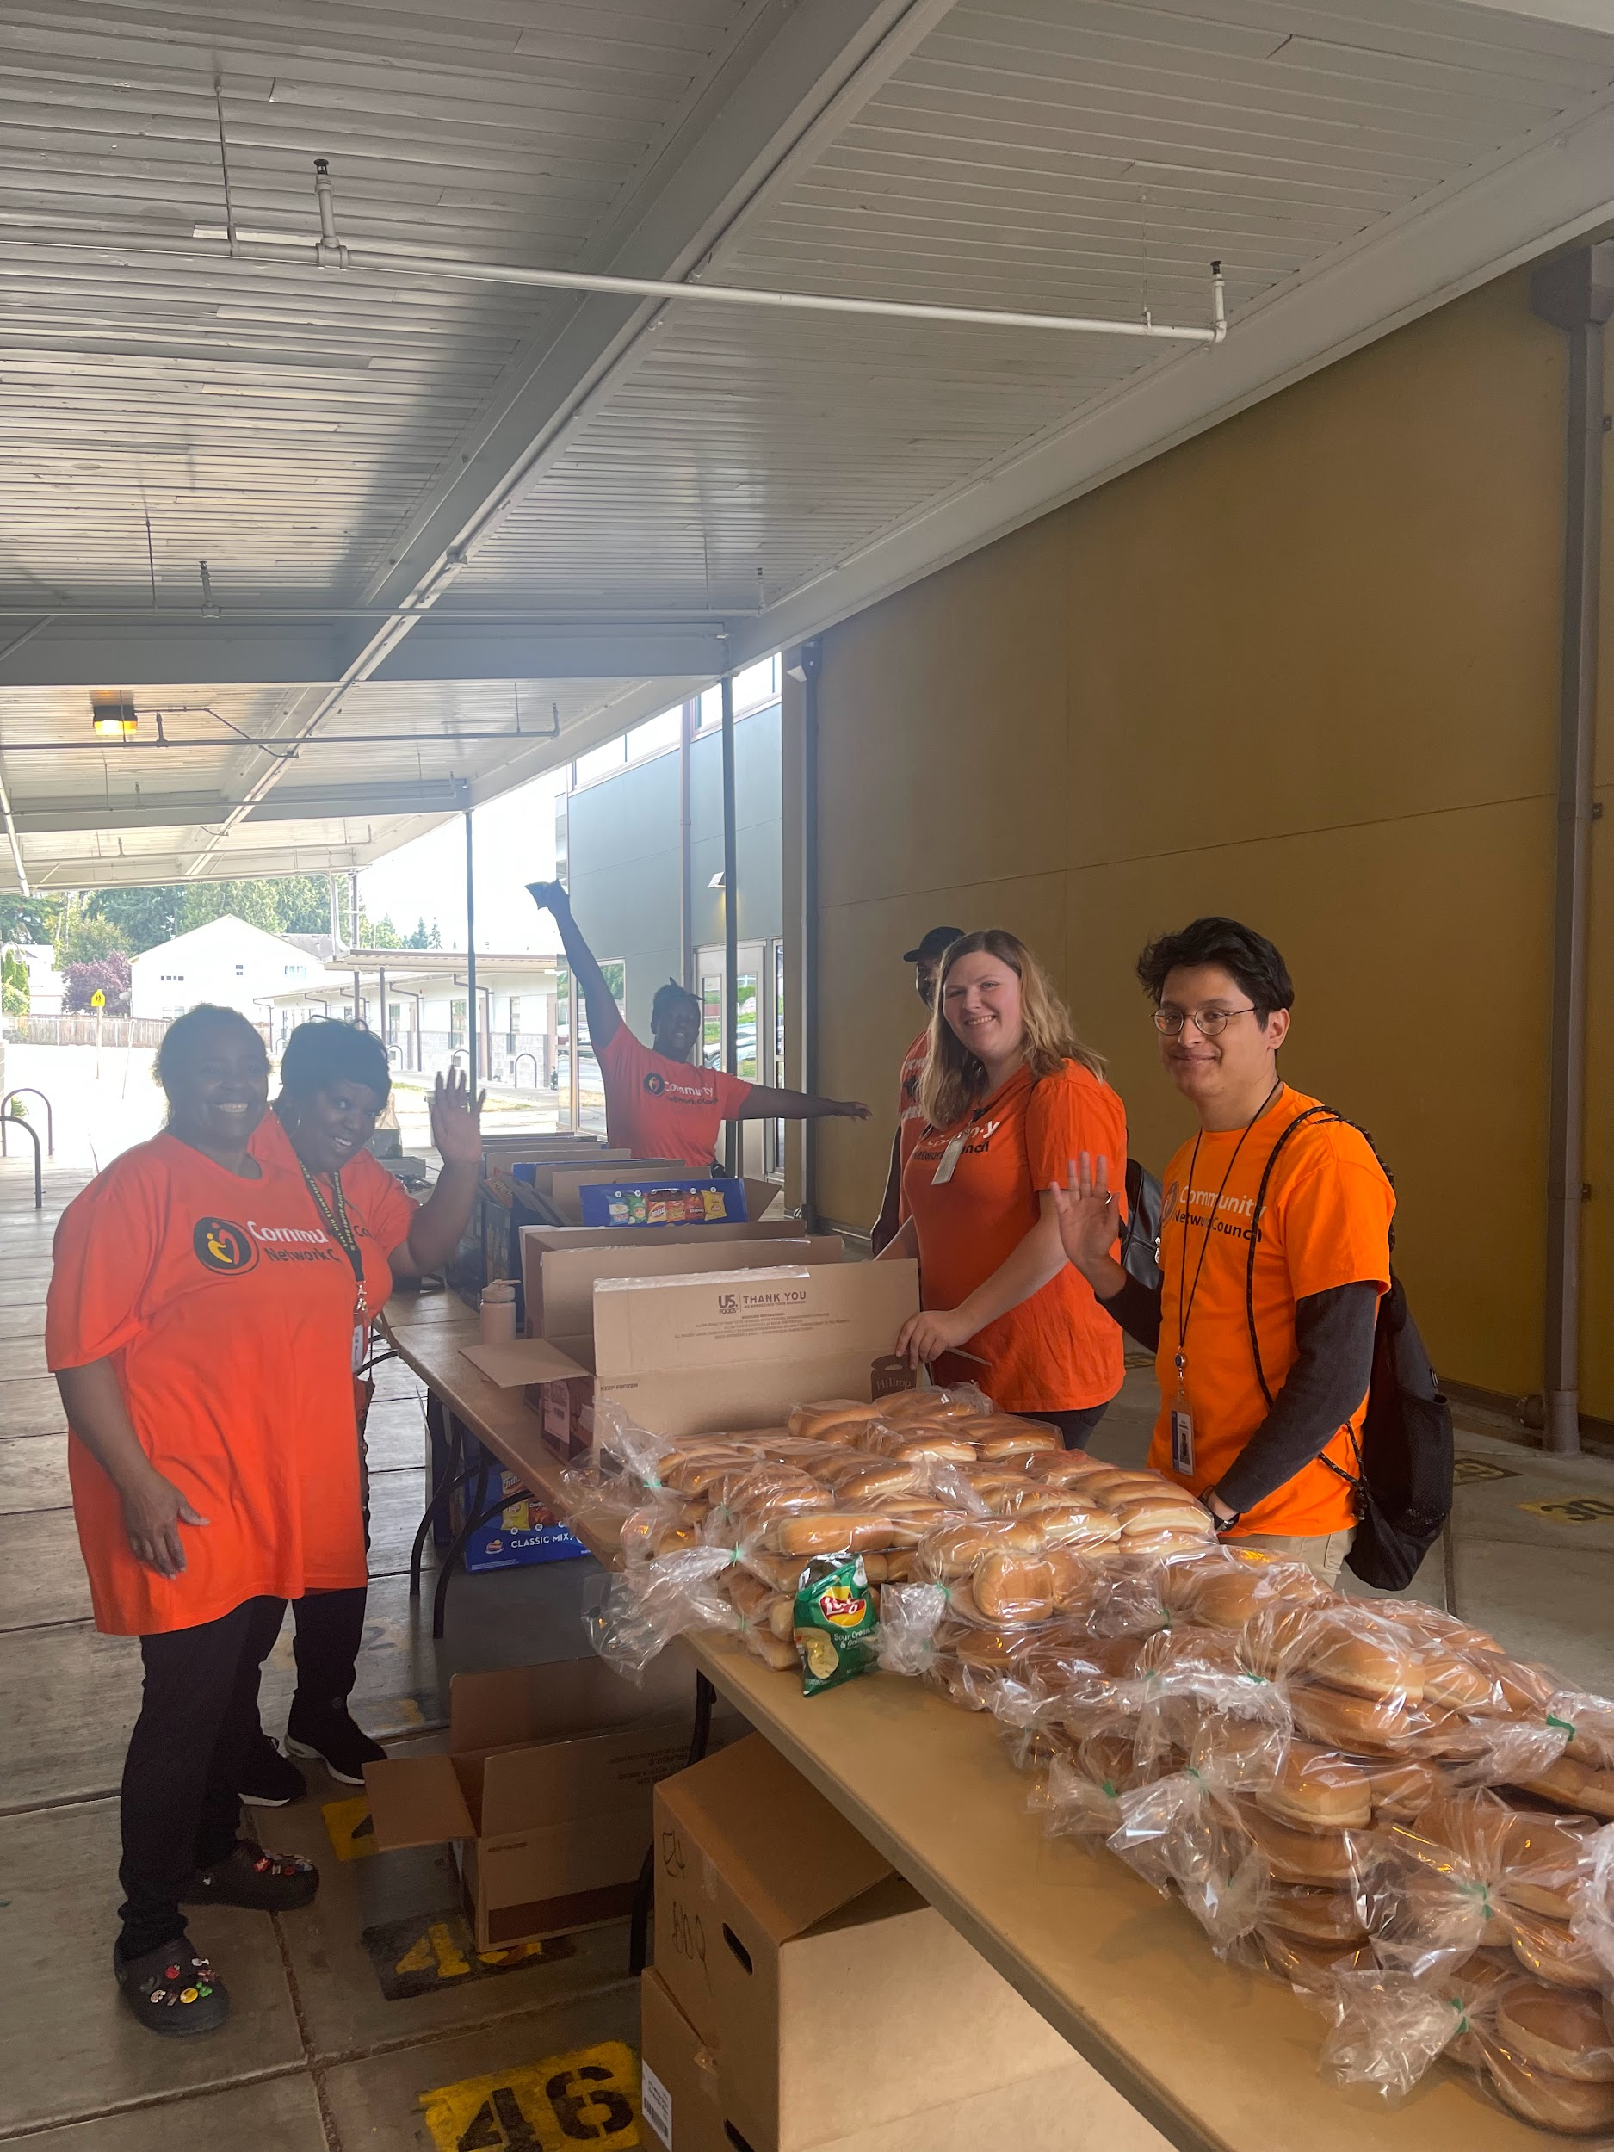
CNC Emergency Feeding Program
EFP Open Hours
Tuesdays
11:00am-1:00pm
Location:
CNC Office
1819 Central Ave S, Suite 72
Kent, WA 98032
Notes:
Partnerships is a key factor in social service collaboration for CNC. Through the Emergency Feeding Program Partnership. It creates an opportunity for CNC to cater to the basic needs of the community weekly. On Tuesdays, from 11am-1:00pm families are able to stop by the CNC office and pick up boxes of groceries and lunch bags. Our food handler coordinator works with the Academic Coaches to connect students with CNC’s feeding program, creating accessibility to food for students on campus.

Slide 28
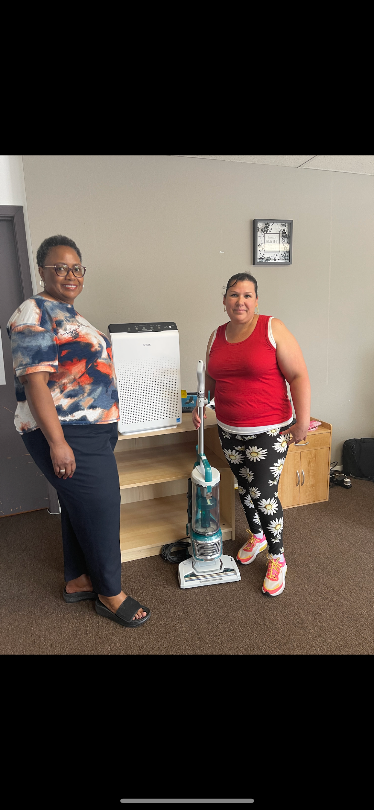
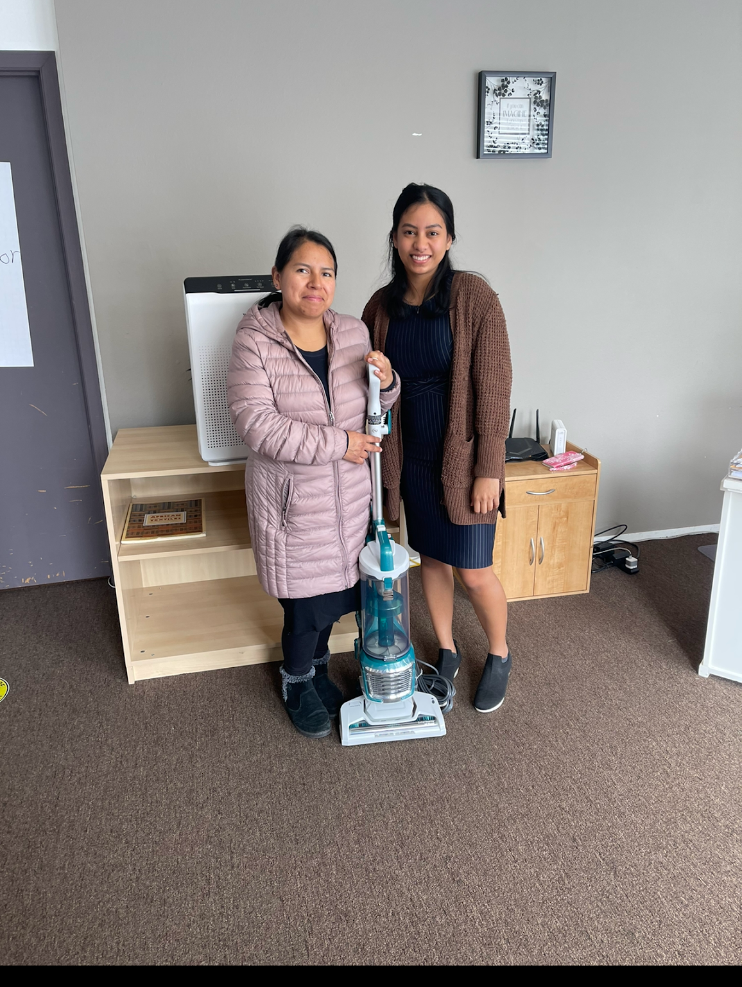
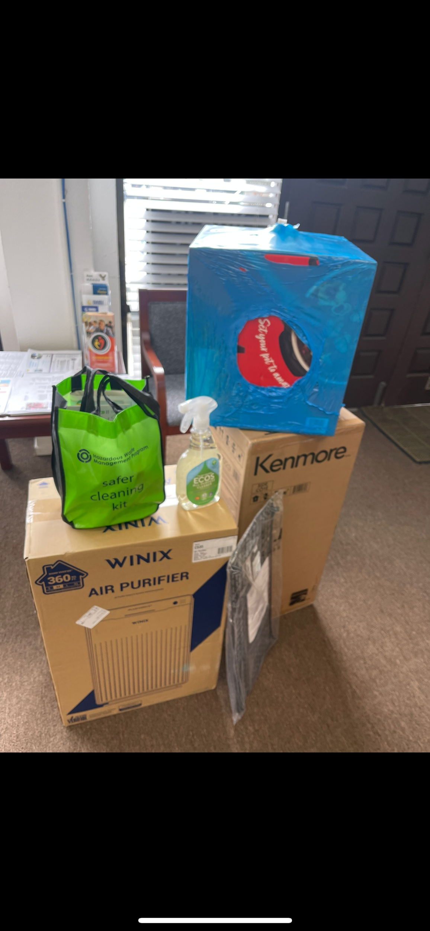
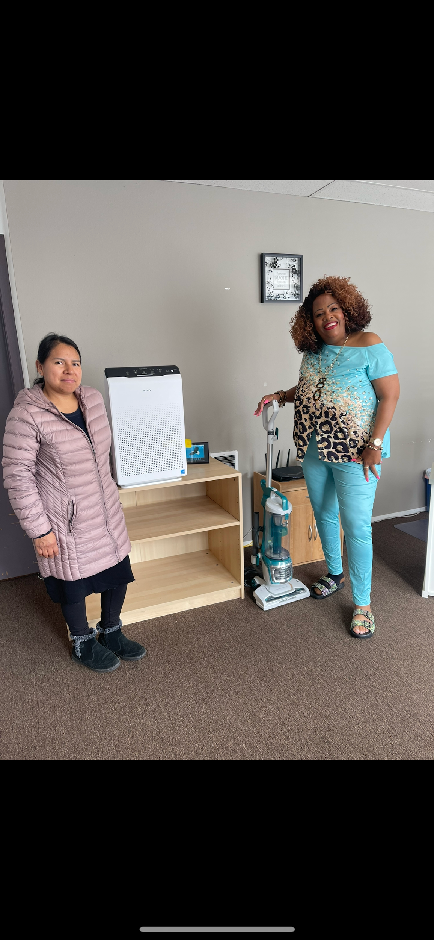
CBO Partnerships/Collaborations: Healthy Homes Project
Notes:
Another great example of partnerships & collaborations is the Healthy Homes Project. Through the collaboration with King County and it’s CBO partners, we were able to co-develop a interactive program focusing on empowering families with knowledge and understanding of indoor health risks. Community Participants were given a opportunity to identify signs of mold, lead, chemical exposure, and learning about the ways to address each matter. Participants were also provided the tools such as HEPA approved vacuum cleaner, eco-friendly disinfectants, air purifier to aid in their action plan on how to eliminate or minimize indoor health exposures.

Slide 29

Notes:
On this slide is CNC ‘s CHW program brochure. It is a developing Community Health & Wellness Program focusing on recognizing health disparities among vulnerable communities of color. We aim to address health disparities in King County, such as the obesity health disparity, the infant mortality rate, and promote indoor air quality through our services such as: interactive educational sessions, equipping of tools, referral, and preventions or guidance plan. Our partners are G2L, King County, Kent Community Development Collaborative, Para Los Ninos. It is a growing program, but we are definitely open to additional partnerships.

Slide 30
Did You Know ?
Approximately 1 in 10 people in the United States lack health insurance, leading to serious implications. Those without insurance are less likely to have a primary care provider and may struggle to afford necessary health care services and medications. Strategies to increase insurance coverage rates are essential for ensuring more people receive essential health care, including preventive care and treatment for chronic illnesses.
Notes:
Other services that G2L and CNC offer is health insurance enrollment through WA Health Plan finder. Here we are going to be jumping into more about health insurance. **READ SLIDE*

Slide 31


What is health insurance?
contract between you and an insurance company. The company agrees to cover some or all of your medical expenses in exchange for your monthly premium payment.
You may qualify for free or low-cost health insurance through WAHBE or WAHPF
There you can apply for Washington Apple Health at little or no cost.

Slide 32
How to apply?
Visit wahealthplanfinder.org to complete an online application or connect with an Health Navigator, CHW. CNC CHW Referral, G2L -Somali, Spanish, English
Washington Apple Health (Medicaid) enrollment is open all year-round; you don’t need a special enrollment period to apply.
If you do not qualify for Apple Health, you may still qualify for special enrollment,

Slide 33
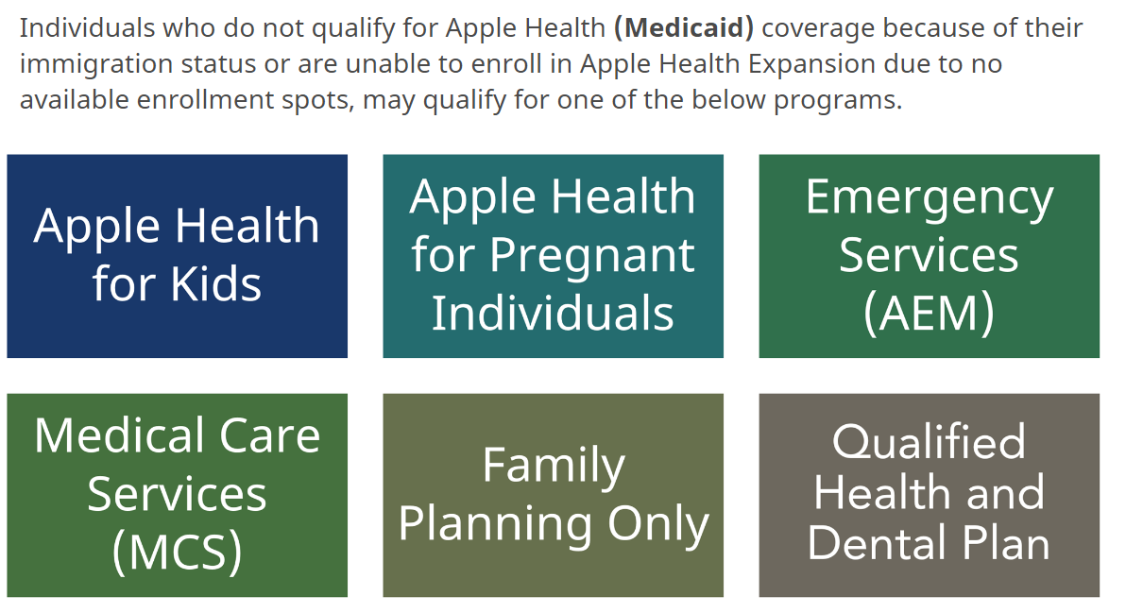

Slide 34


Slide 35
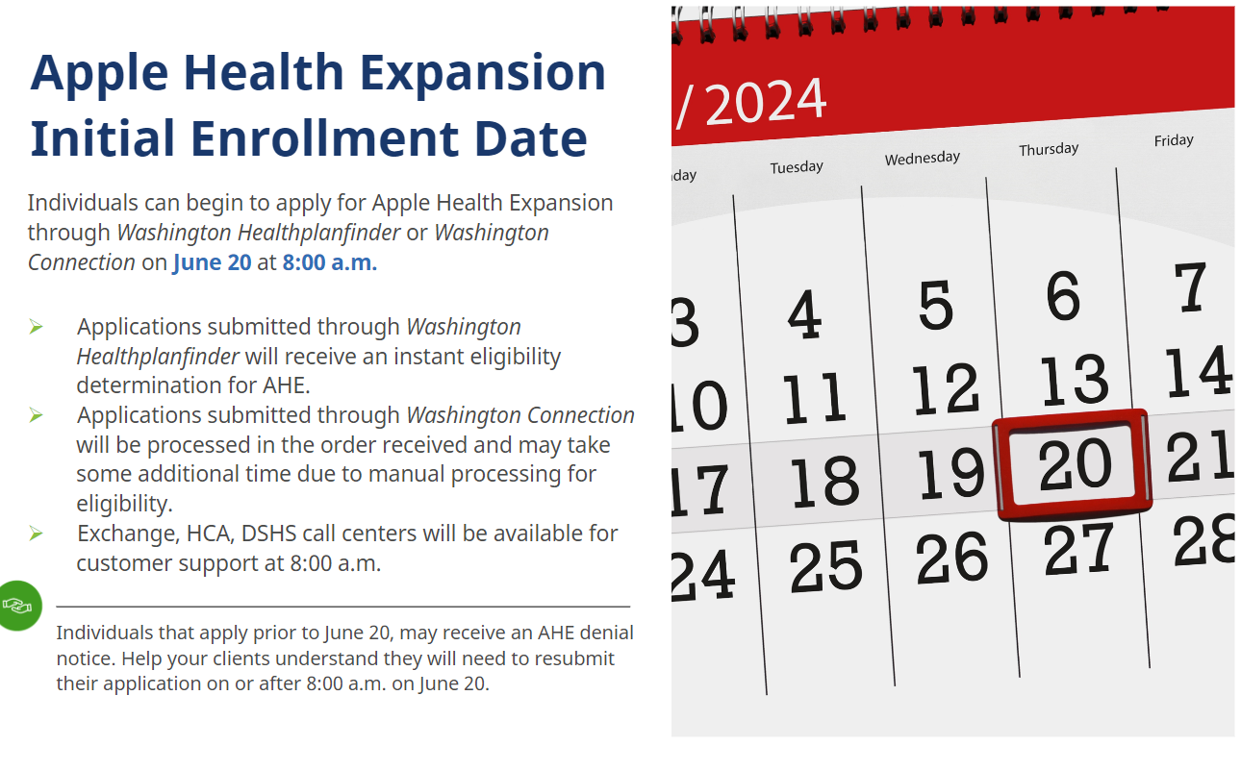

Slide 36
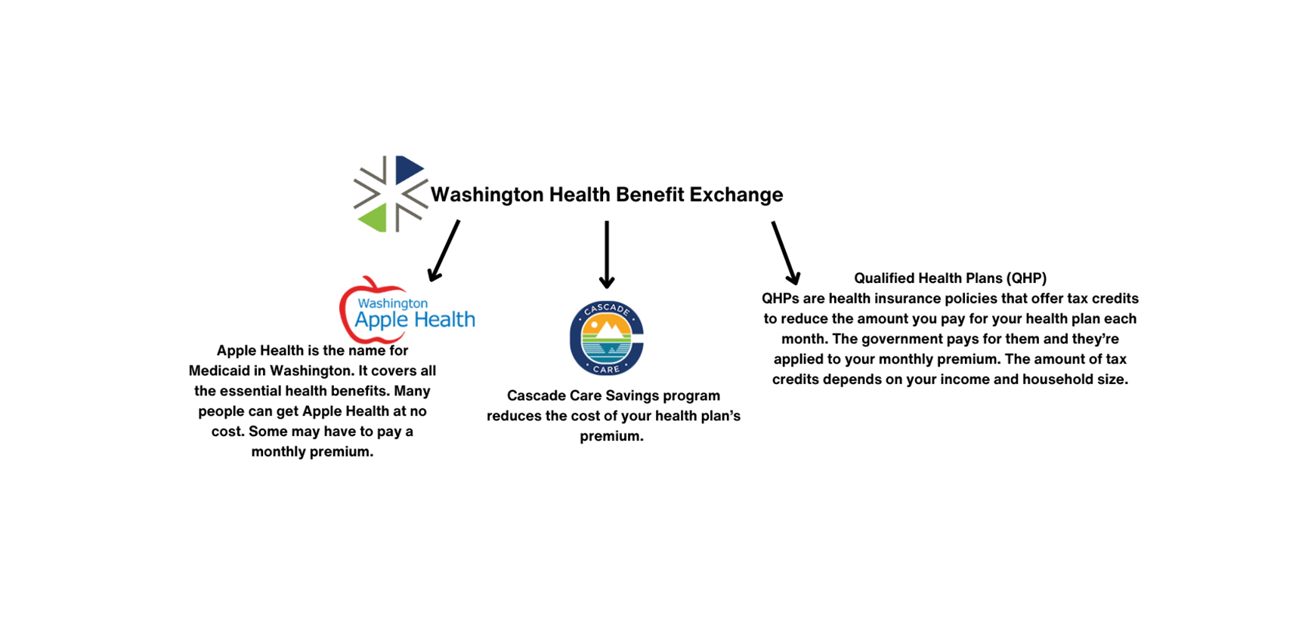
Notes:
There are 3 type of Health Plan under the WA Health Benefit Exchange aka WA Healthplanfinde. one qualifies depending on their income and household number. There is Apple Health (Medicaid) , Cascade Care Savings Program, and Qualified Health Plan.

Slide 37
Avoid Burnout / Identify the symptoms
Burnout is a state of mental, physical, and emotional exhaustion. Some symptoms include:
· Physical symptoms
Headaches, muscle pain, stomachaches, fatigue, frequent illness, back aches, and bodily tension
· Emotional symptoms
Helplessness, cynicism, sense of failure or self-doubt, decreased satisfaction, feeling detached or alone in the world, loss of motivation, irritability, hopelessness, and low accomplishment
· Behavioral signs
Reduced performance in everyday tasks, withdrawal or isolation, procrastination, outbursts, using substances to cope, and speaking up in meetings and/or volunteering for projects less often
Notes:
Wooh! well that concludes our services slide, I know we shared ALOT of information & we want to thank everyone for being here today. As CHW’s our work can be challenging, but your work is valuable and beneficial. we would like to end this session with a quick destressing activity. Before we move forward, we want to take this moment to remind ourselves that burnout can be serious & can be a state of mental, physical, and emotional exhaustion . **READ LIST OF SYMPTOMS**

Slide 38
Activity
Share your recommended self-care or practice to avoid burnout
JOB Resource: Valleymed.org/careers-Patient Resource Rep
NW Handling Systems/nwhs.com (no experience required)
Notes:
Quick fill your cup exercise , reminder for self-care, destress

Slide 39
Lean on each other & ask for help
work collectively , we all have a shared goal of helping our community
l
learn what other organizations /services are in your area & the type of work they do for possible collaboration .
take a break when needed , find ways that help you decompress from a long work day
Rest and Reset
know our community is also looking out for us.

Slide 40
Utility citations
https://www.seattle.gov/utilities/your-services/discounts-and-incentives/utility-discount-program
https://www.seattle.gov/human-services/services-and-programs/utility-discount-program
https://www.pse.com/en/account-and-billing/assistance-programs/bill-discount-rate
https://www.pse.com/en/account-and-billing/assistance-programs/HELP

Slide 41
Citations
https://www.dshs.wa.gov/altsa/home-and-community-services/senior-farmers-market-nutrition-program
https://www.washingtonconnection.org/home/
https://www.dshs.wa.gov/sunbucks
https://kingcounty.gov/en/dept/dph/health-safety/health-centers-programs-services/maternity-support-wic/wic-supplemental-nutrition-program
https://www.seattlefreshbucks.org/
https://www.dshs.wa.gov/esa/community-services-offices/basic-food

Slide 42

Enjoy your Summer !!
Notes:
Survey

